Slide 1
Unlocking the Power of Dynamics 365 Business Central Telemetry
A Practical Guide to Getting Started
Ways to Strategically Use Telemetry Data in Partner Practices

Slide 2
Agenda
Telemetry power demos for the account manager, the project manager, and the supporter
Its as easy as 1-2-3 to get started
Business case and ROI
Common usage scenarios
Recent developments
Maturity model
Resources

Slide 3
Telemetry is just a fancy word for “usage data”
Data
Insights
Actions

Slide 4
Telemetry power demos
For the account manager, the project manager, and the supporter

Slide 5
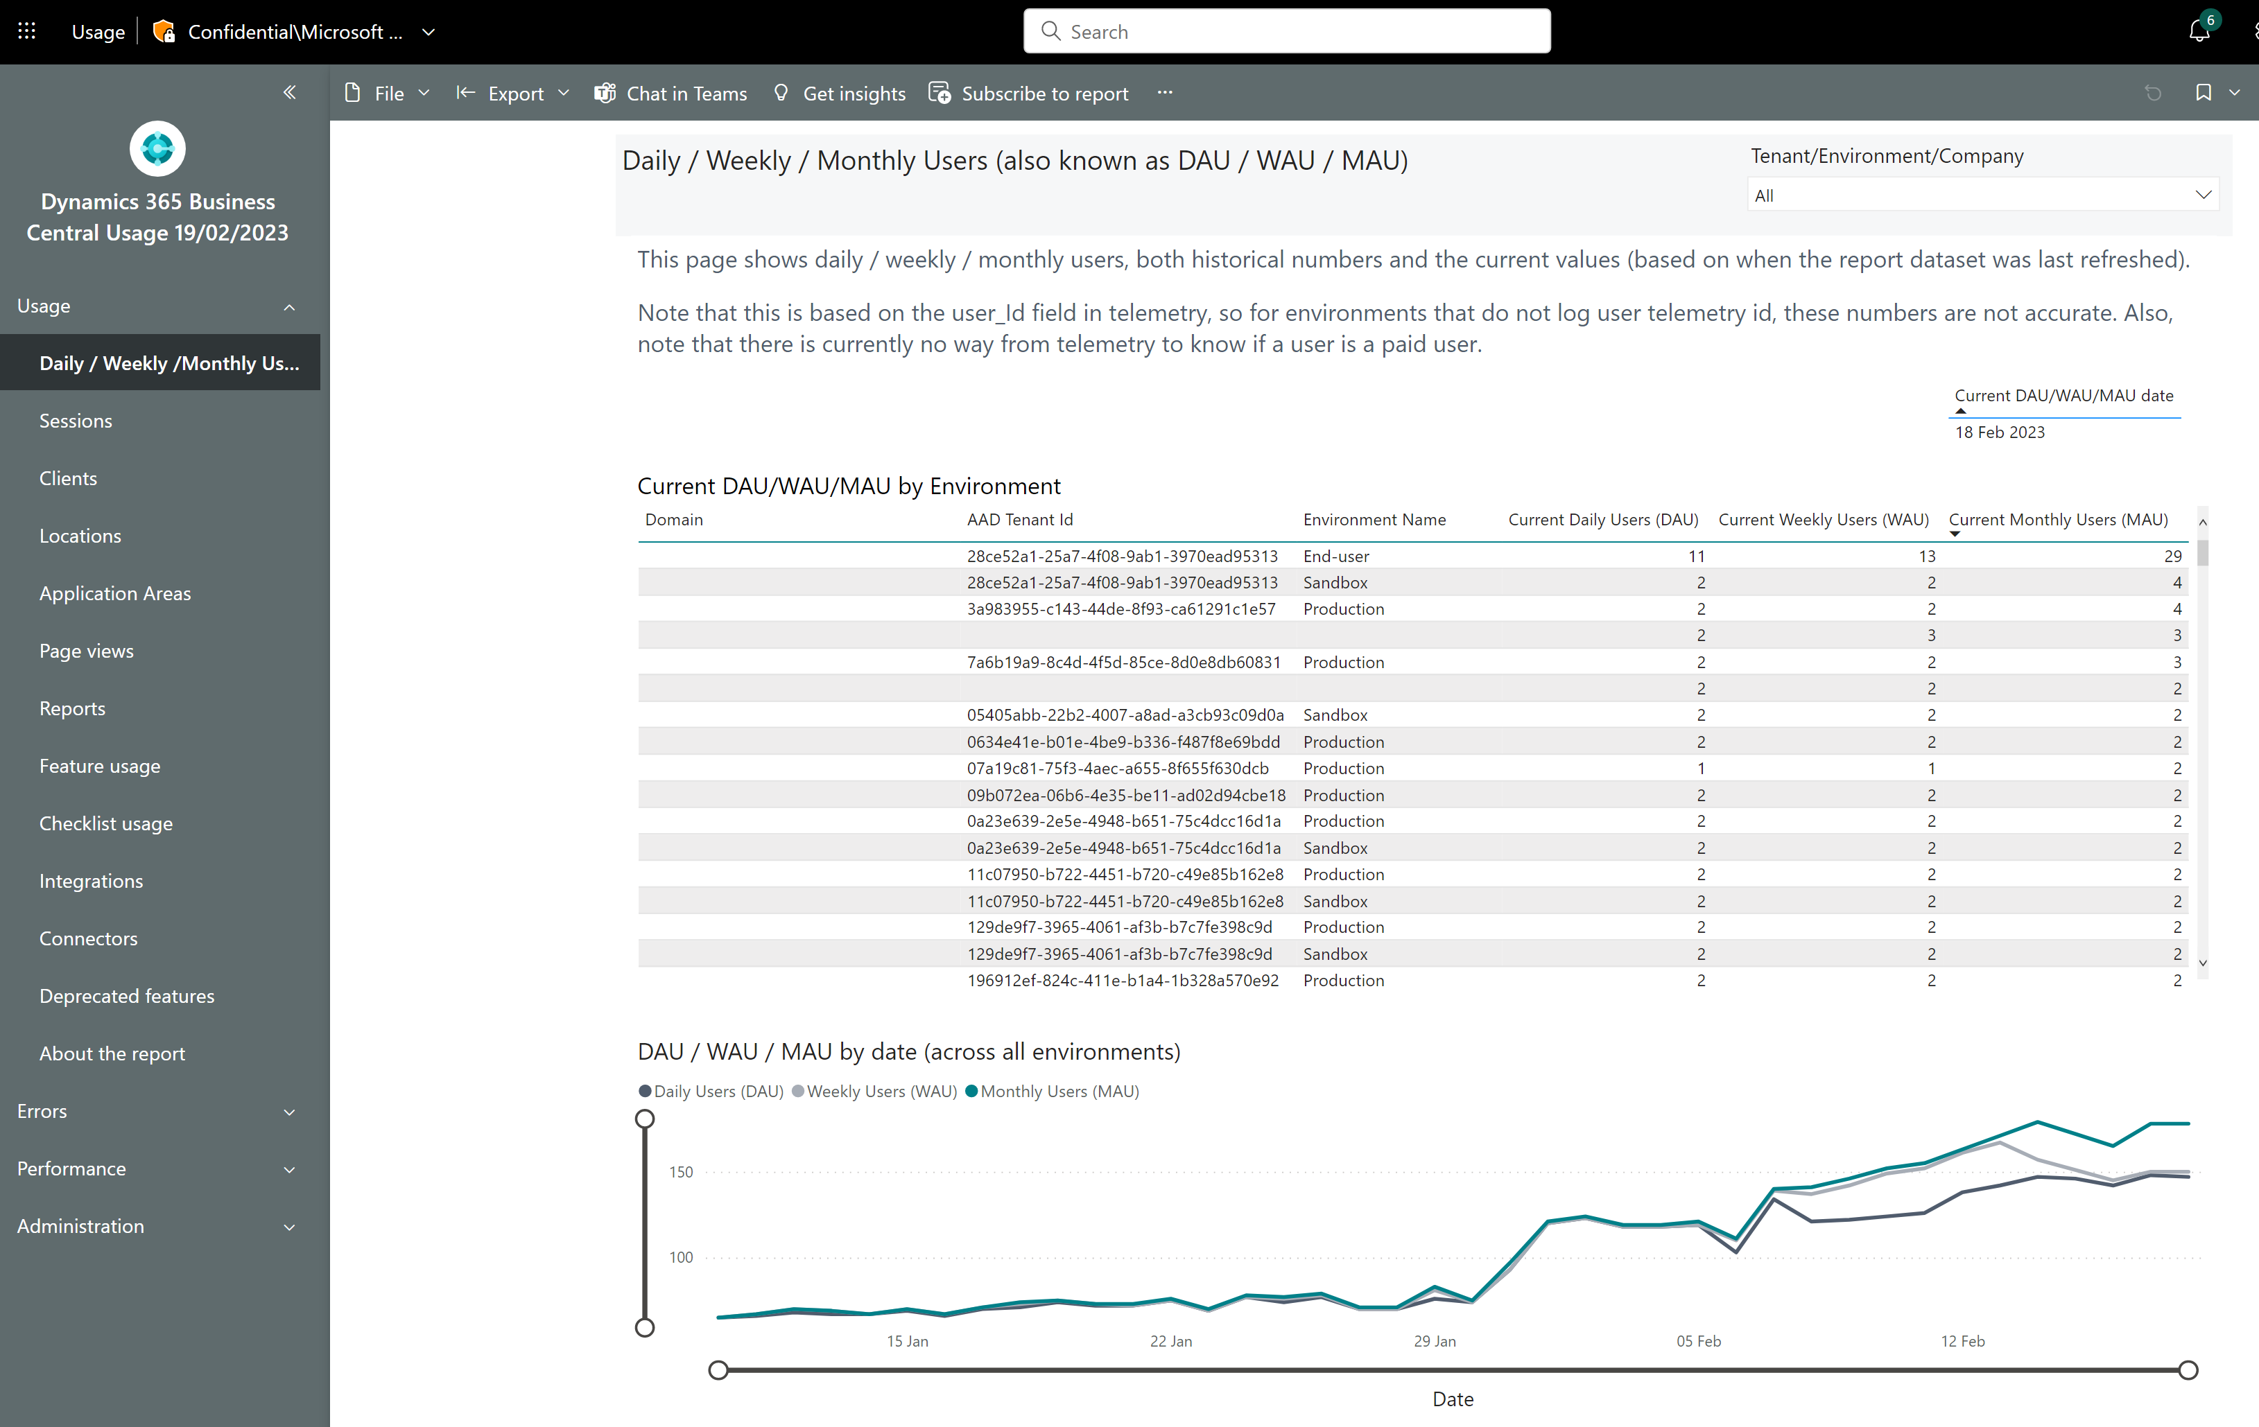
Track daily/weekly/monthly usage
See current usage
Track usage numbers over time

Slide 6
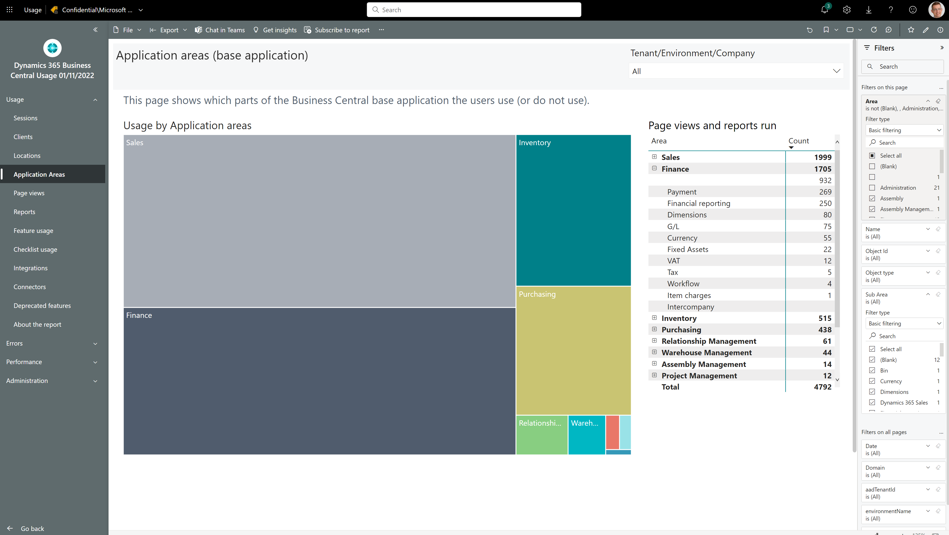
How to see which standard features customers use
Notes:
Filter away Areas with Empty, Bland, Administration, or Other

Slide 7
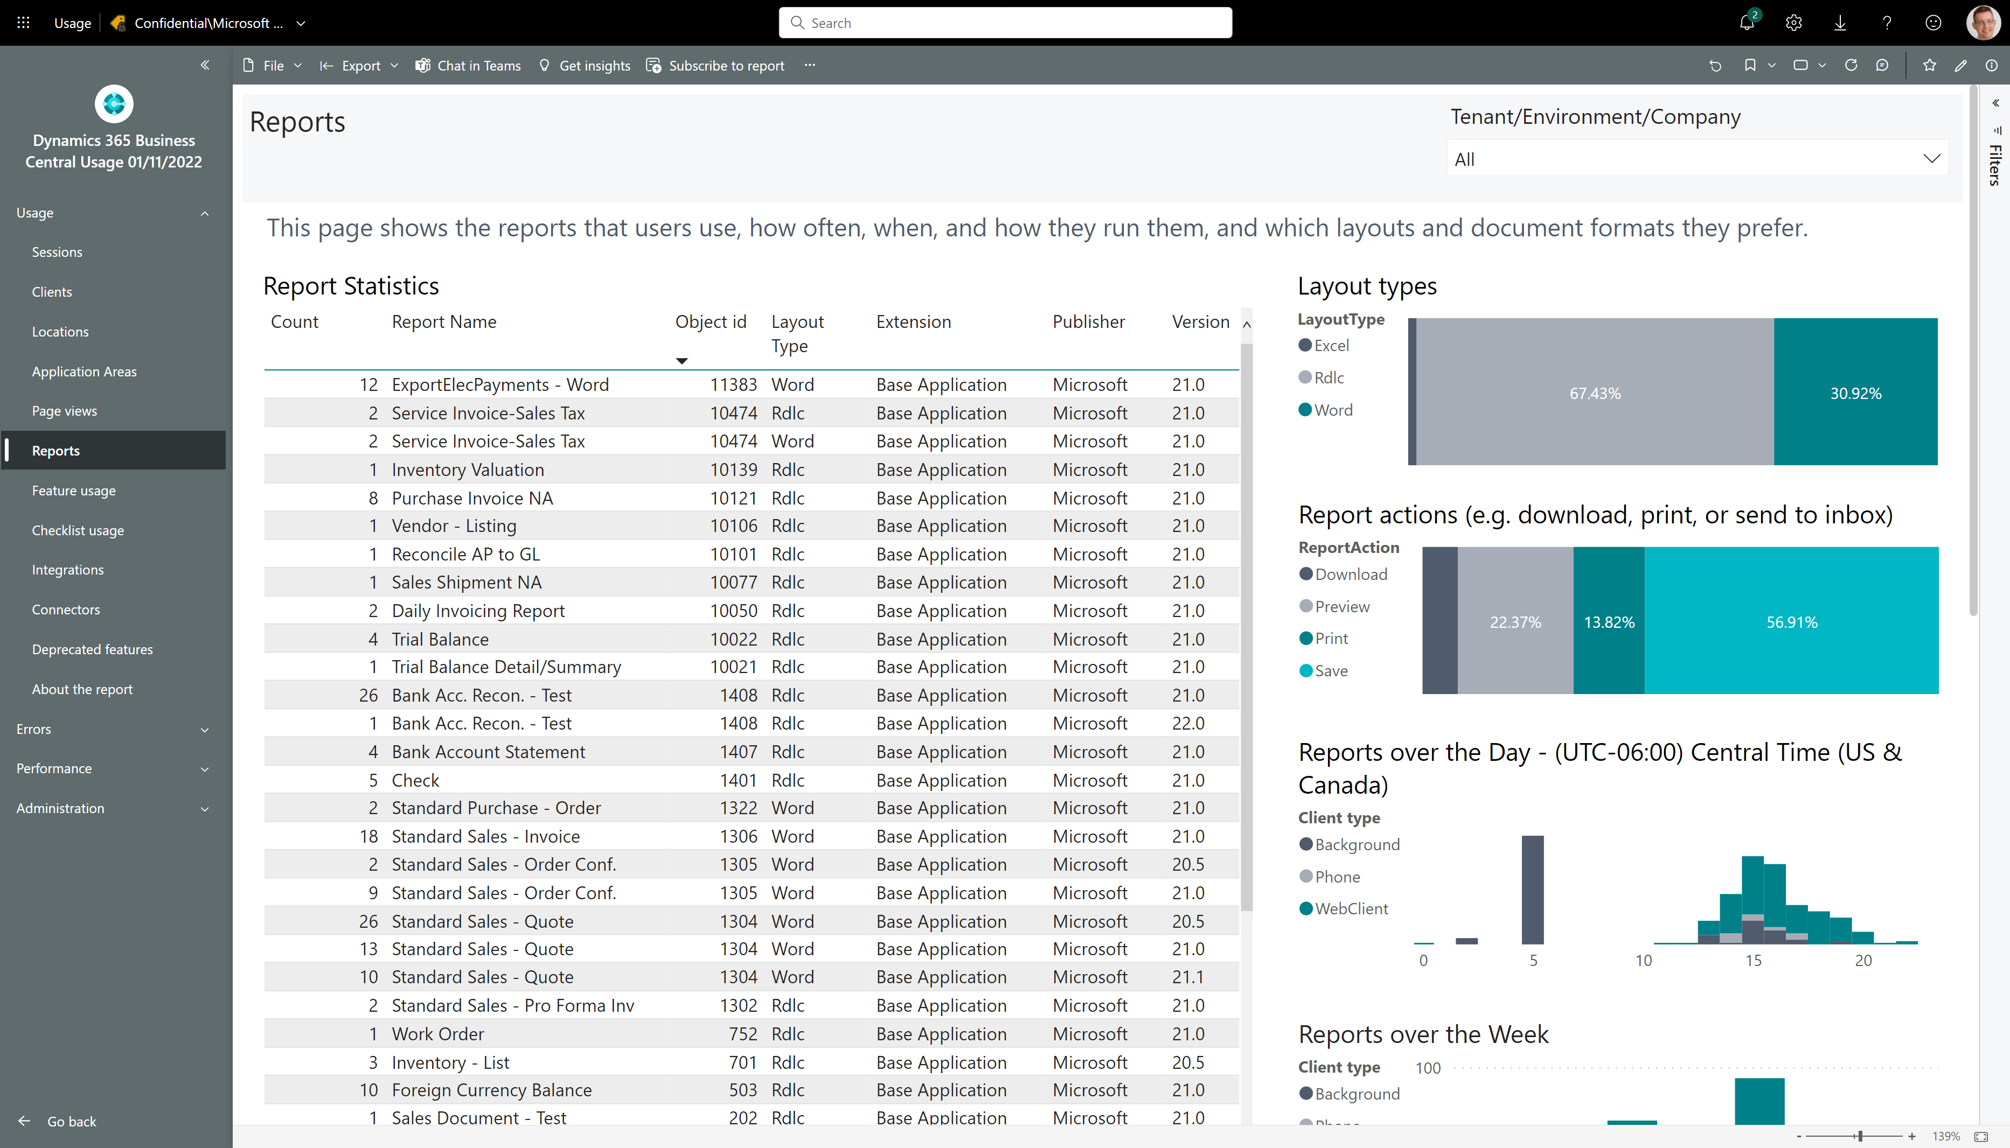
How to see if customer is using Excel layouts

Slide 8
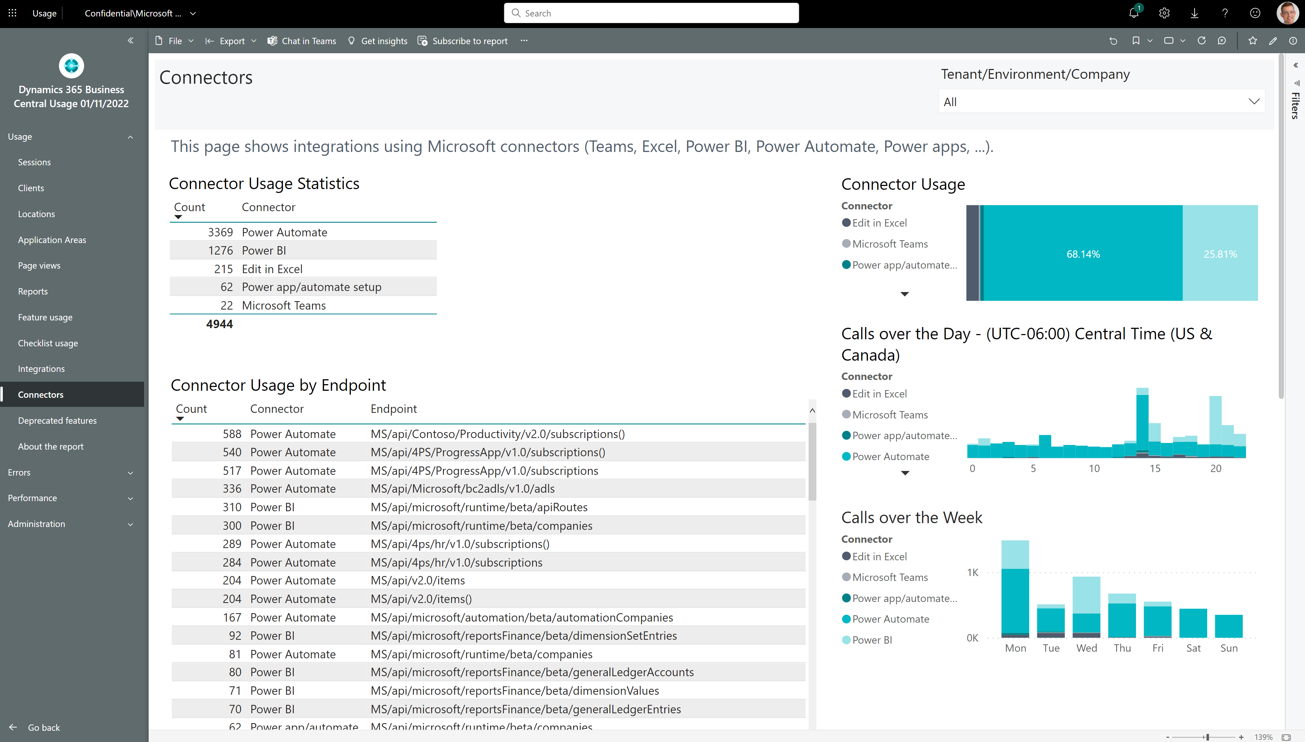
How to see if customer is using Microsoft connectors

Slide 9
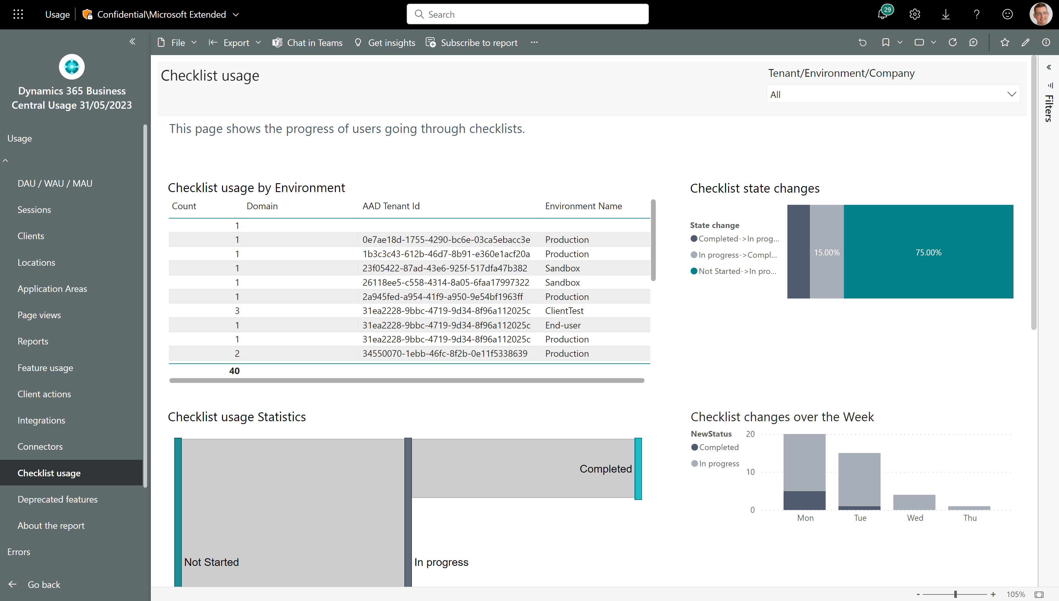
How to follow up on onboarding activities
Track checklists across customers
Track checklist progress

Slide 10
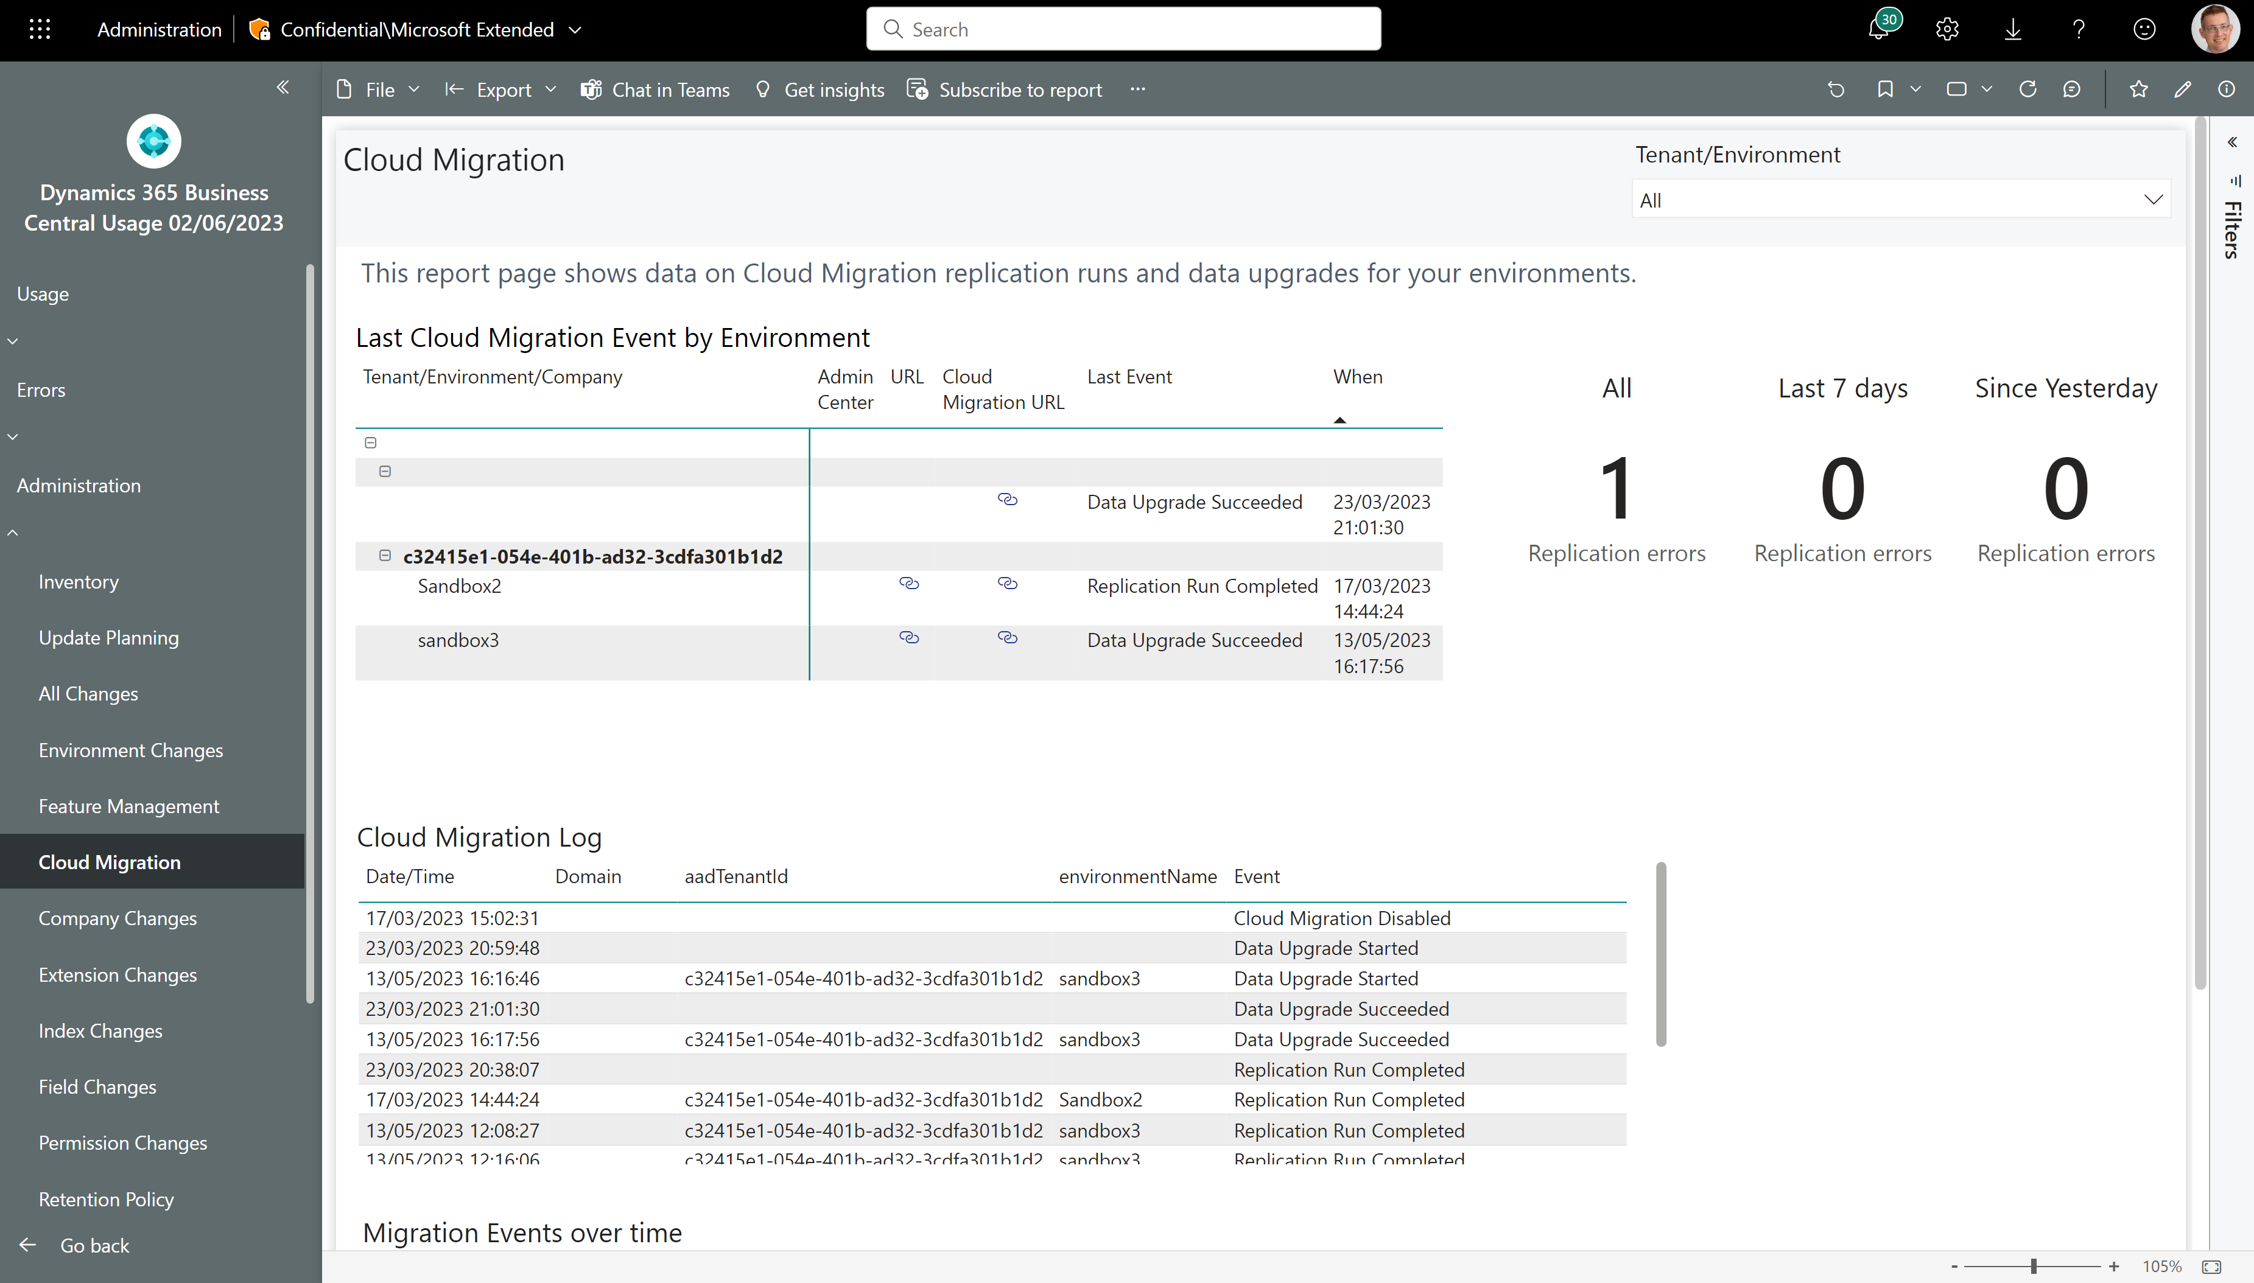
Track progress to cloud migrations
Error KPIs that work with Power BI metrics
What is current status across environments?
Browse the log
Track things over time

Slide 11
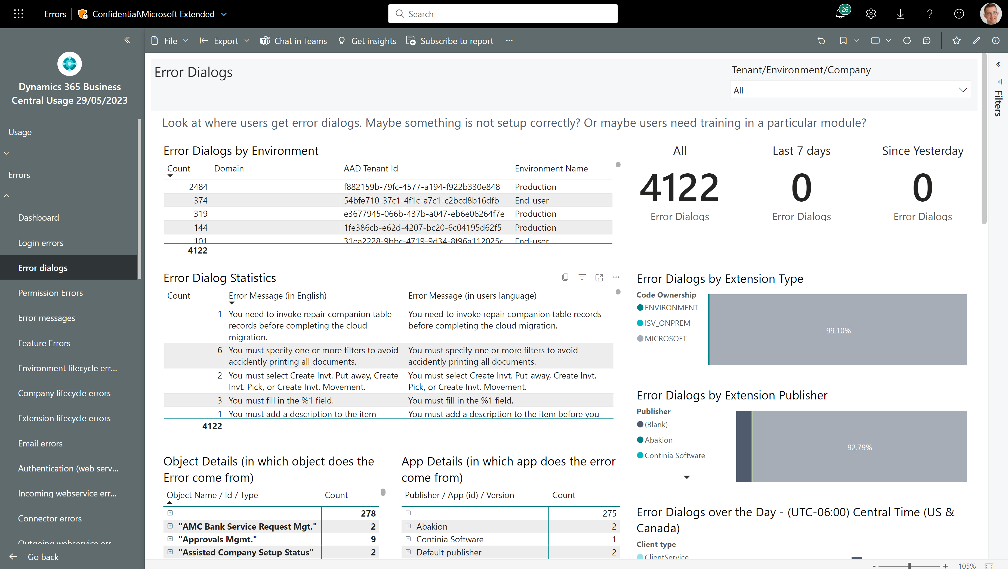
Troubleshoot errors that users see
Which customers experience errors?
What errors do users see?
And what is the error message in English?
Which apps and objects do errors come from?

Slide 12
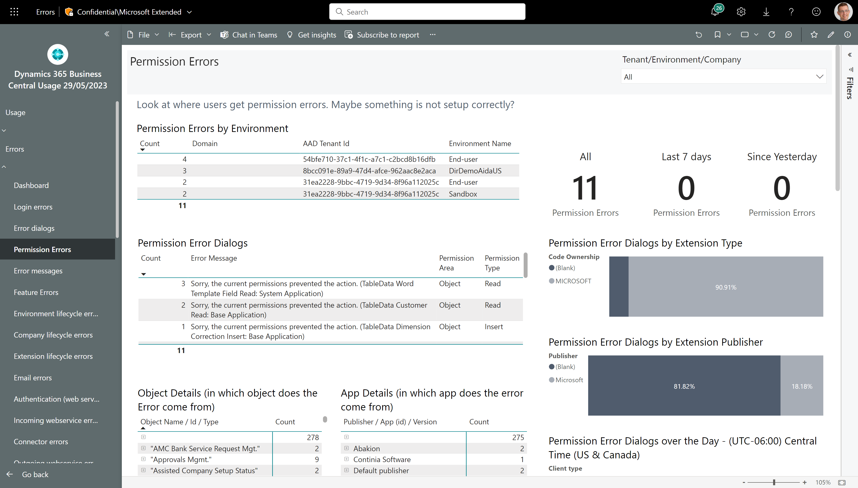
Troubleshoot permission issues
Which customers experience permission issues?
What errors do users see?
Which apps and objects do errors come from?

Slide 13
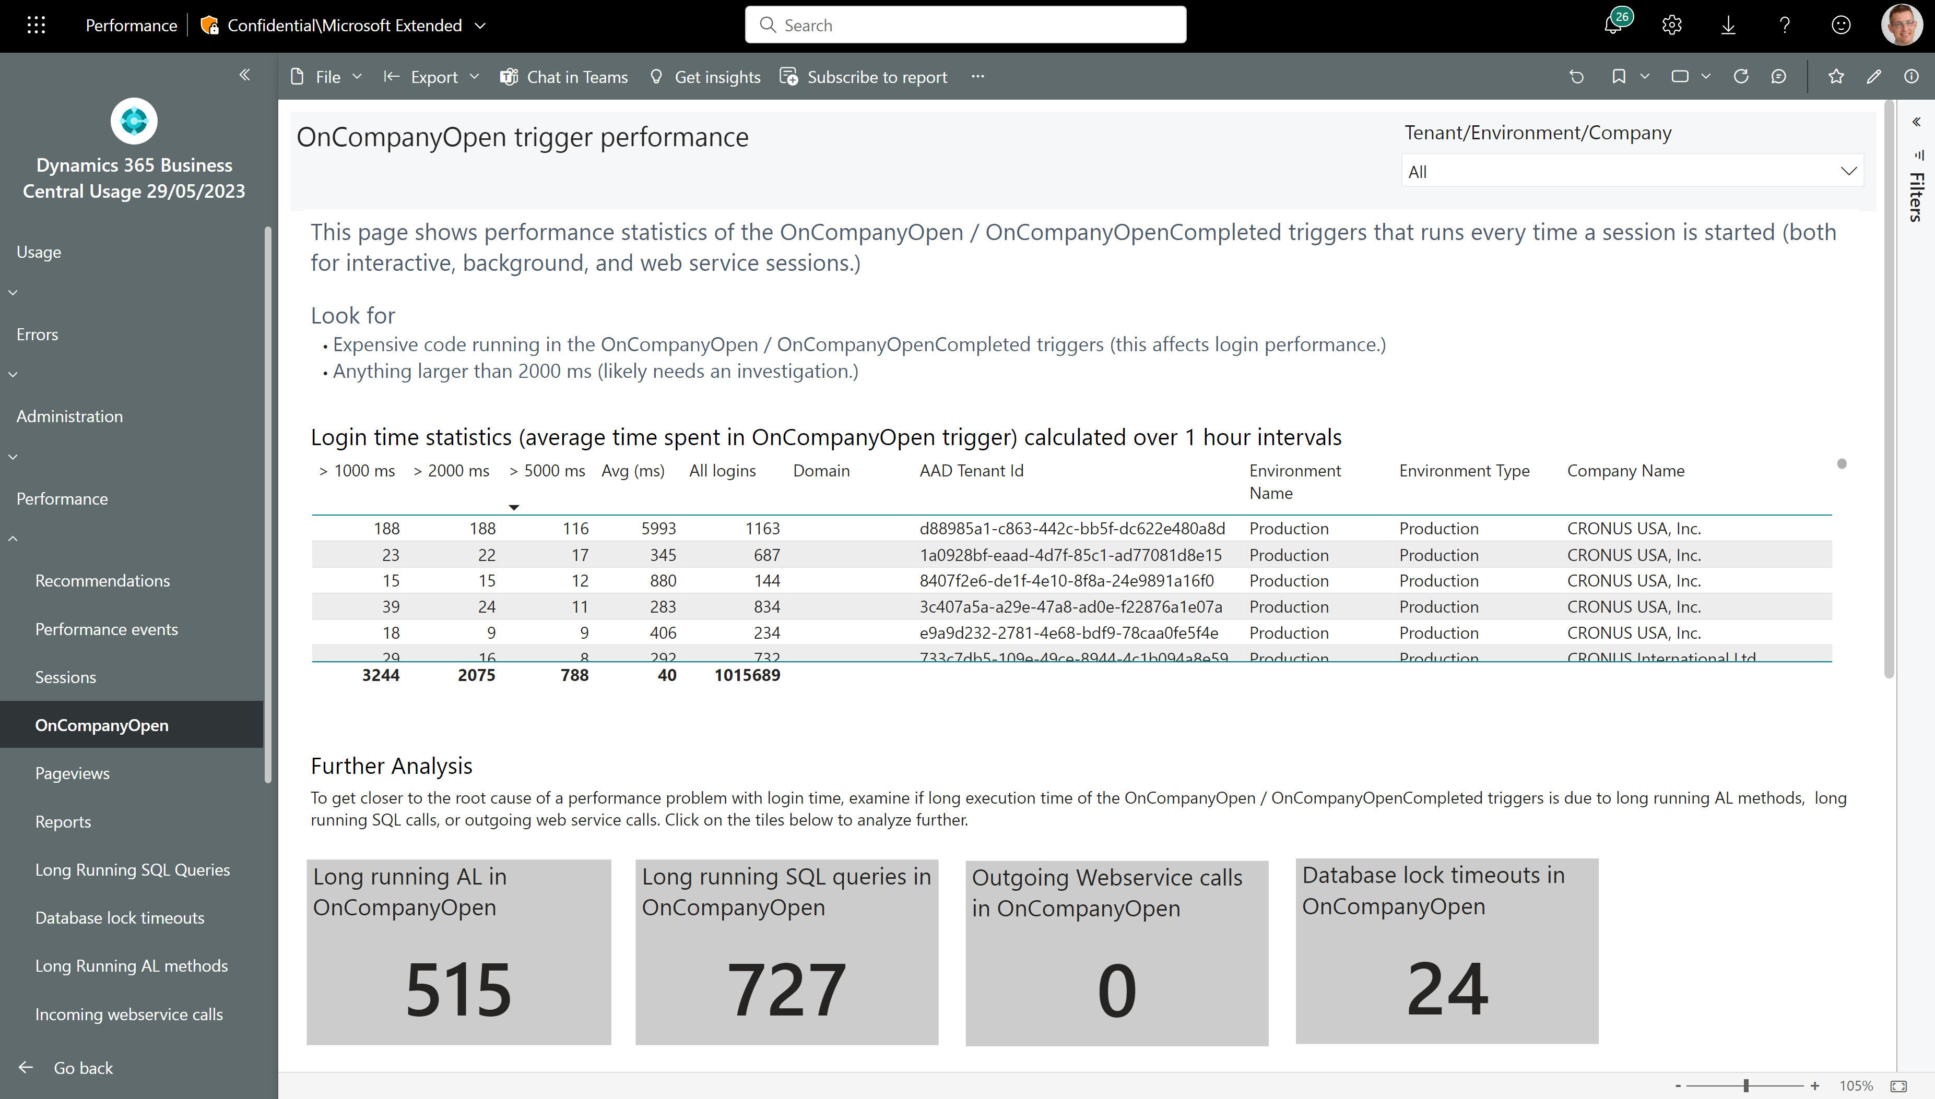
Login performance
None of these should happen

Slide 14
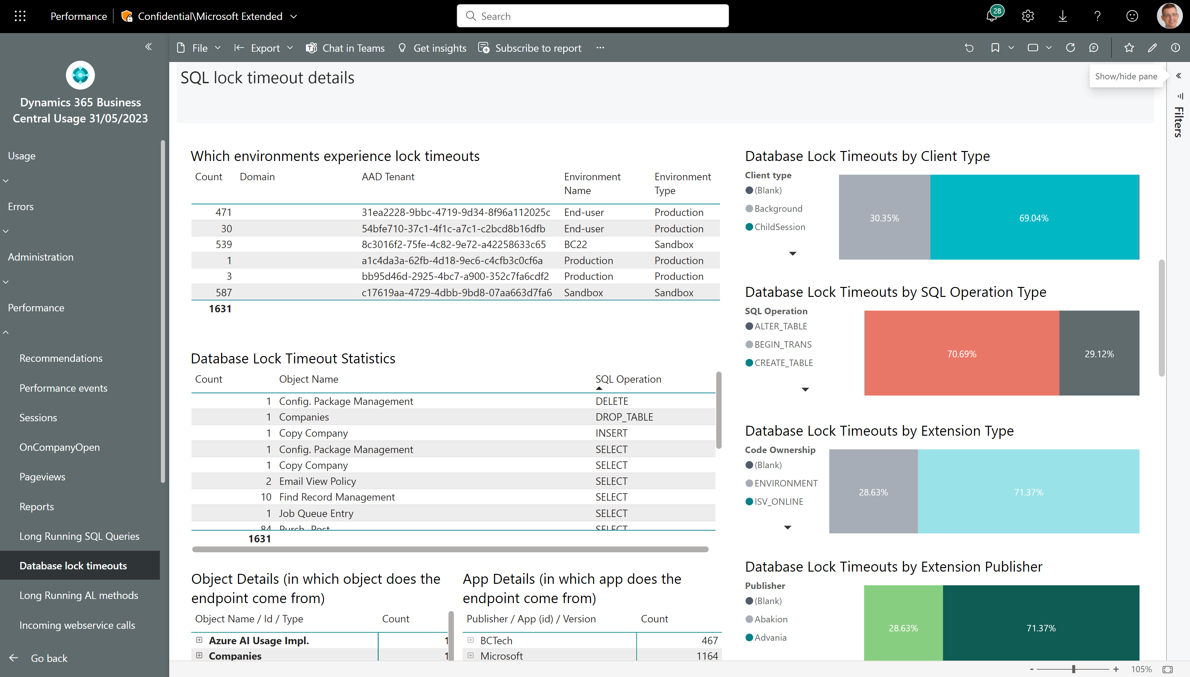
Analyzing database locks - 1
See impact across environments
UI or background sessions?
What type of SQL operation wanted to lock?
Which objects in which apps were affected?

Slide 15
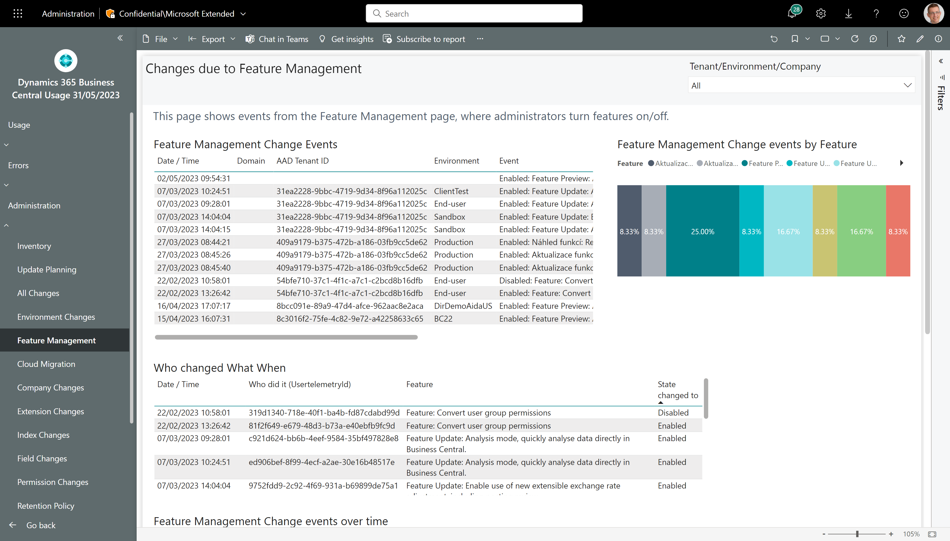
Track changes to Feature Management switches
See changes across all environments
Who did it?
And when?

Slide 16
Its as easy as 1-2-3
… to get started with telemetry

Slide 17
It’s as simple as 1, 2, 3
Set up AppInsights for one or more environments
1
Deploy Power BI apps from Appsource
2
Monitor your environments
3
Notes:
High-level takeaway

Slide 18
To get telemetry, you need to do two things
Create an Application Insights resource in Azure
Configure Online Business Central environments in the Tenant Admin Center, or
Configure On-premises Business Central environments using Powershell cmdlets, or
Configure your Business Central app in the app.json manifest file

Slide 19
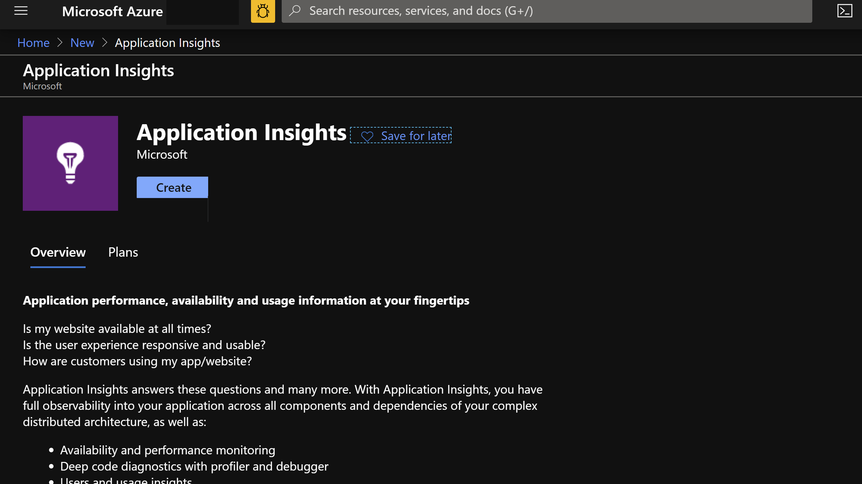

Slide 20
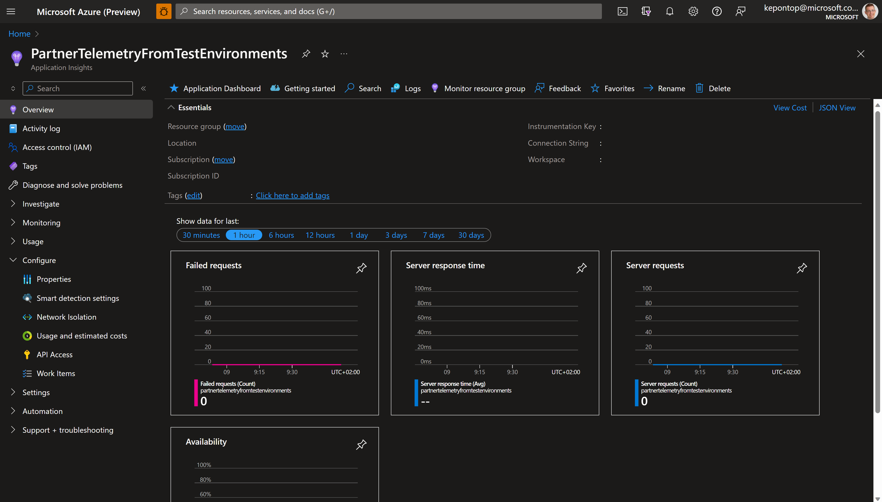
You need to copy this

Slide 21
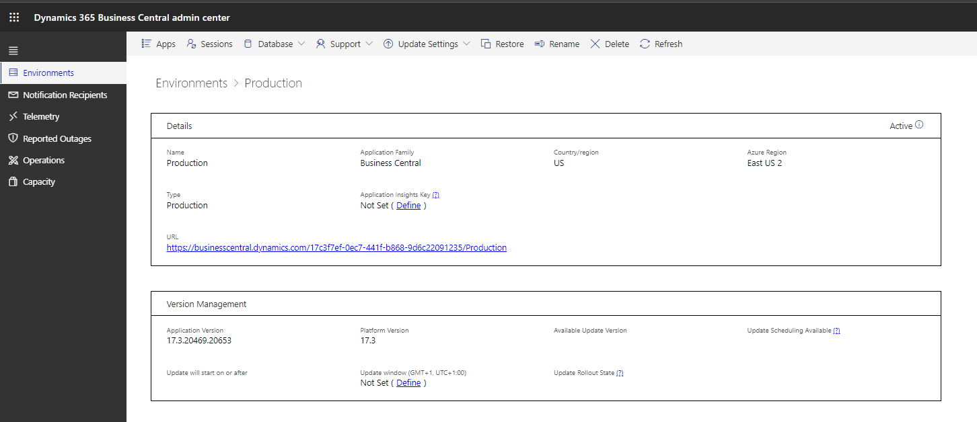
Notes:
App Insights key is per environment. This is BYO (Bring Your Own) AppInsights
See
https://docs.microsoft.com/en-us/dynamics365/business-central/dev-itpro/administration/tenant-admin-center-telemetry#sending-telemetry-to-microsoft-azure-application-insights

Slide 22
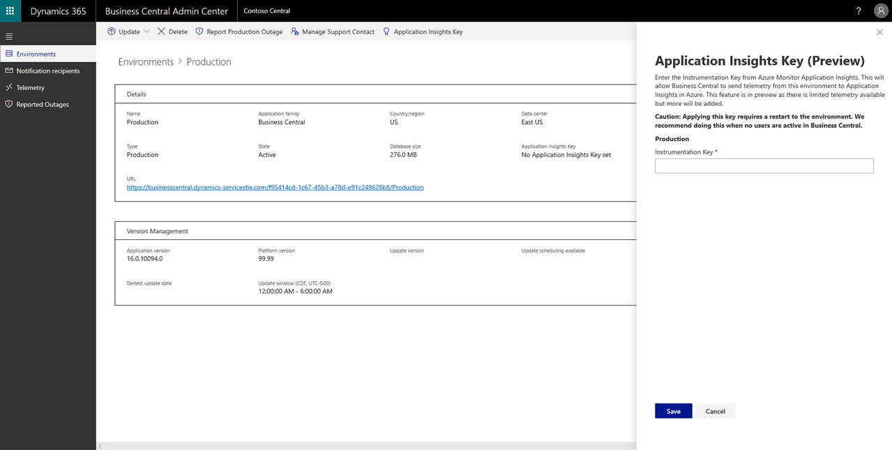
Notes:
Caution: will require a tenant environment restart. Do it off-hours (will cancel all sessions), takes 1-2 minutes to get the environment back online

Slide 23
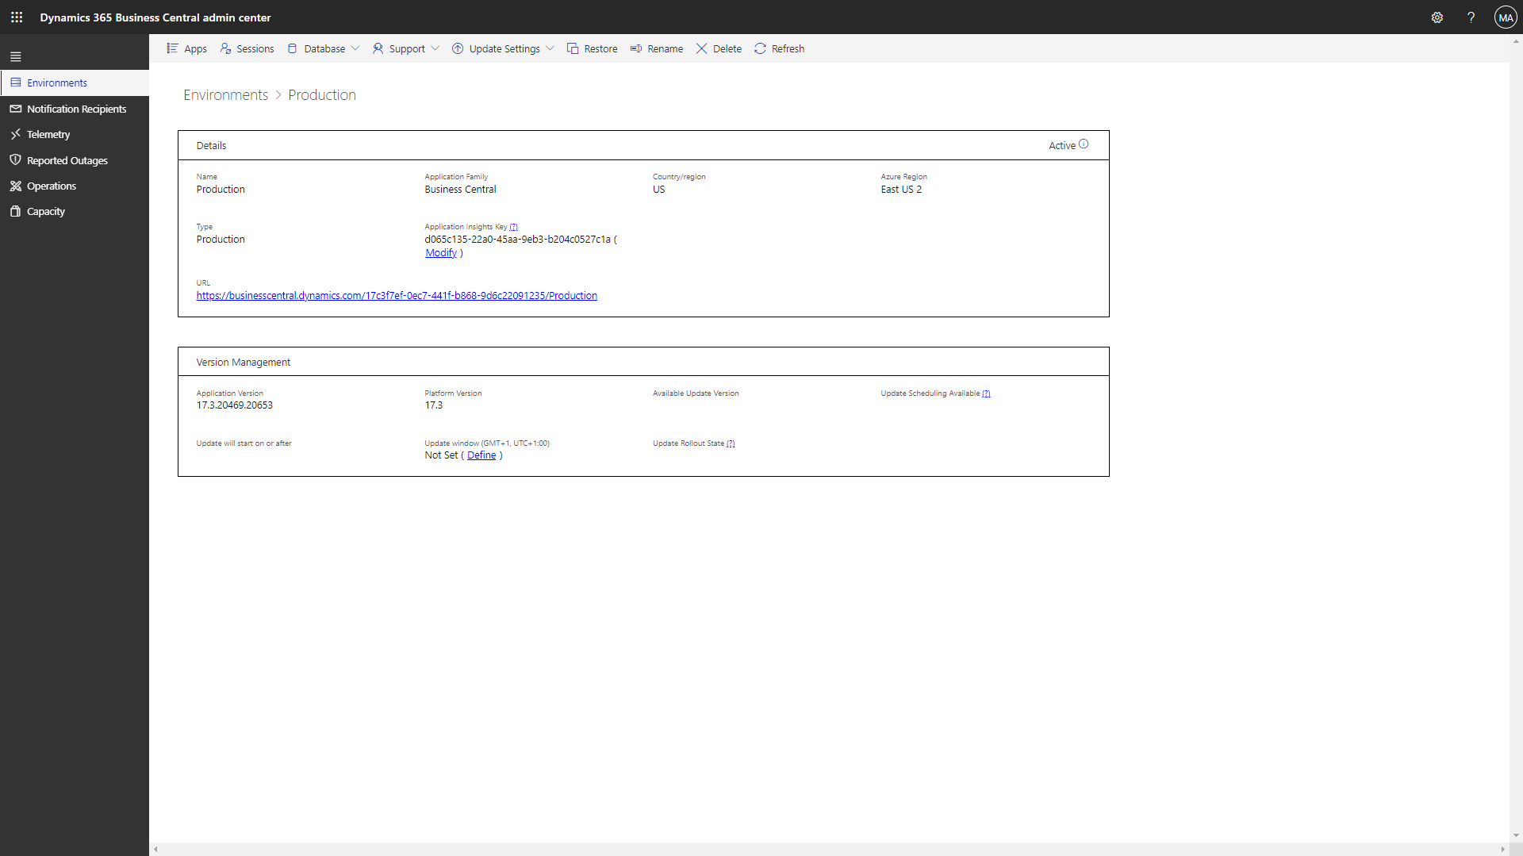
Notes:
Now the instrumentation key is registered with the application servers (NSTs)

Slide 24
Works also on-prem
Use Powershell cmdlets to inject Application Insights key into the NST
Single Tenant mode (2019 release wave 2, version 16.1)
Set-NAVServerConfiguration
-KeyName ApplicationInsightsInstrumentationKey -KeyValue <guid>
-ApplyTo All -ServerInstance <instance name>
Multi Tenant mode (2019 release wave 2, version 16.0)
Mount-NAVTenant -AadTenantId <aad guid>
-DatabaseName <database name> -Id <tenant id>
-DisplayName <tenant name>
-ApplicationInsightsKey <guid>
Notes:
See
https://docs.microsoft.com/en-us/dynamics365/business-central/dev-itpro/administration/telemetry-enable-application-insights

Slide 25
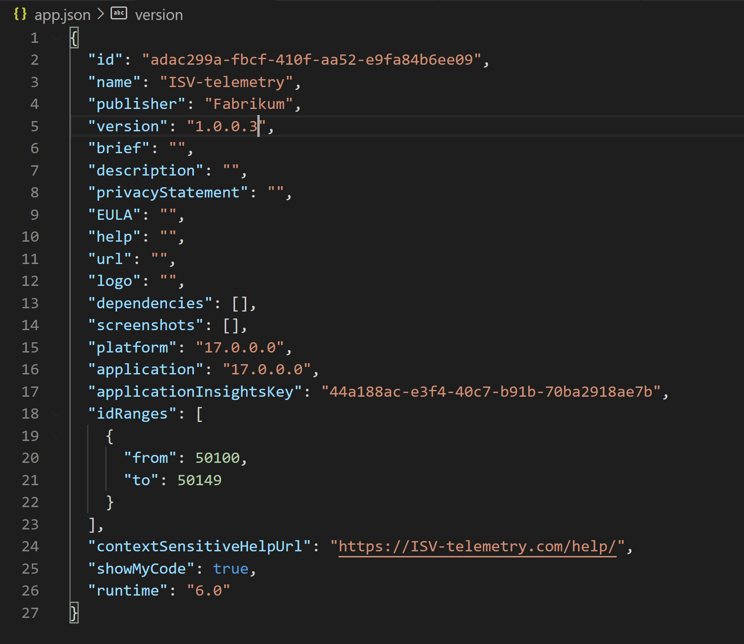
How to setup telemetry for an app

Slide 26
Business case and ROI

Slide 27
Telemetry Return-On-Investment (ROI) questions
Costs
Possible savings
Enabling telemetry + installing/configuring the Power BI app takes 15-30 minutes (end-to-end)
Telemetry costs is appr. 10 USD per month (can be controlled).
The Power BI app is free, but costs 10 USD per month per user.
How many hours per month will the app save the project wrt status progress reporting?
How many hours per month will the app save the project wrt go-live quality?
How many hours per month will the app save within the support org?
If the answer is 1 hour or more per month, then telemetry has a positive ROI.
Notes:
Costs
Enabling telemetry + installing/configuring the Power BI app takes 15-30 minutes (end-to-end)
Telemetry costs is appr. 10 USD per month (can be controlled).
The Power BI app is free, but costs 10 USD per month per user.
Possible savings
How many hours per month will the app save the project wrt status reports?
How many hours per month will the app save the project wrt go-live quality?
How many hours per month will the app save within the support org?
If the answer is 1 hour or more per month, then I think telemetry+app has a positive ROI and it will be cheaper for the team to onboard than not.

Slide 28
Common usage scenarios

Slide 29
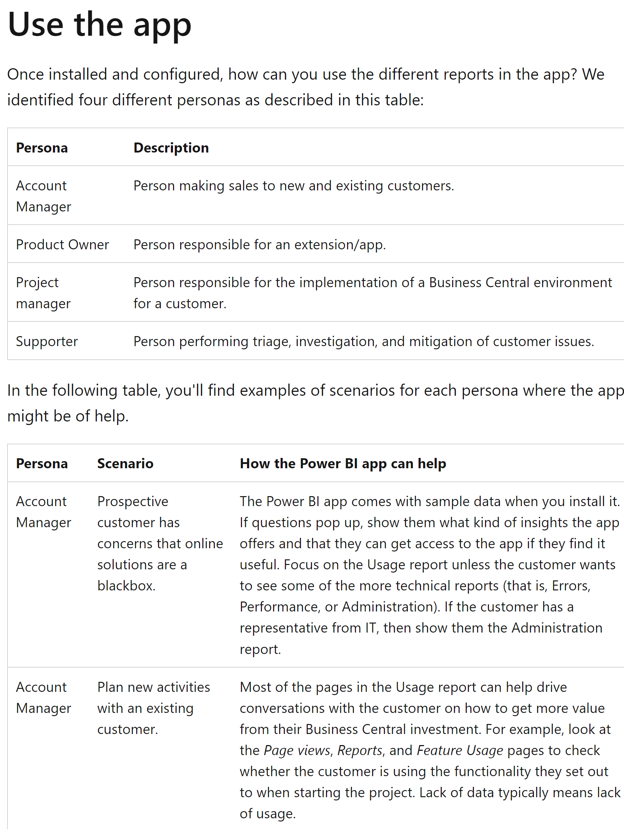
Personas and usage scenarios
https://learn.microsoft.com/en-us/dynamics365/business-central/dev-itpro/administration/telemetry-power-bi-app#use-the-app

Slide 30
Recent developments
Data-driven go-lives with Power BI metrics
AI-assisted performance investigations

Slide 31
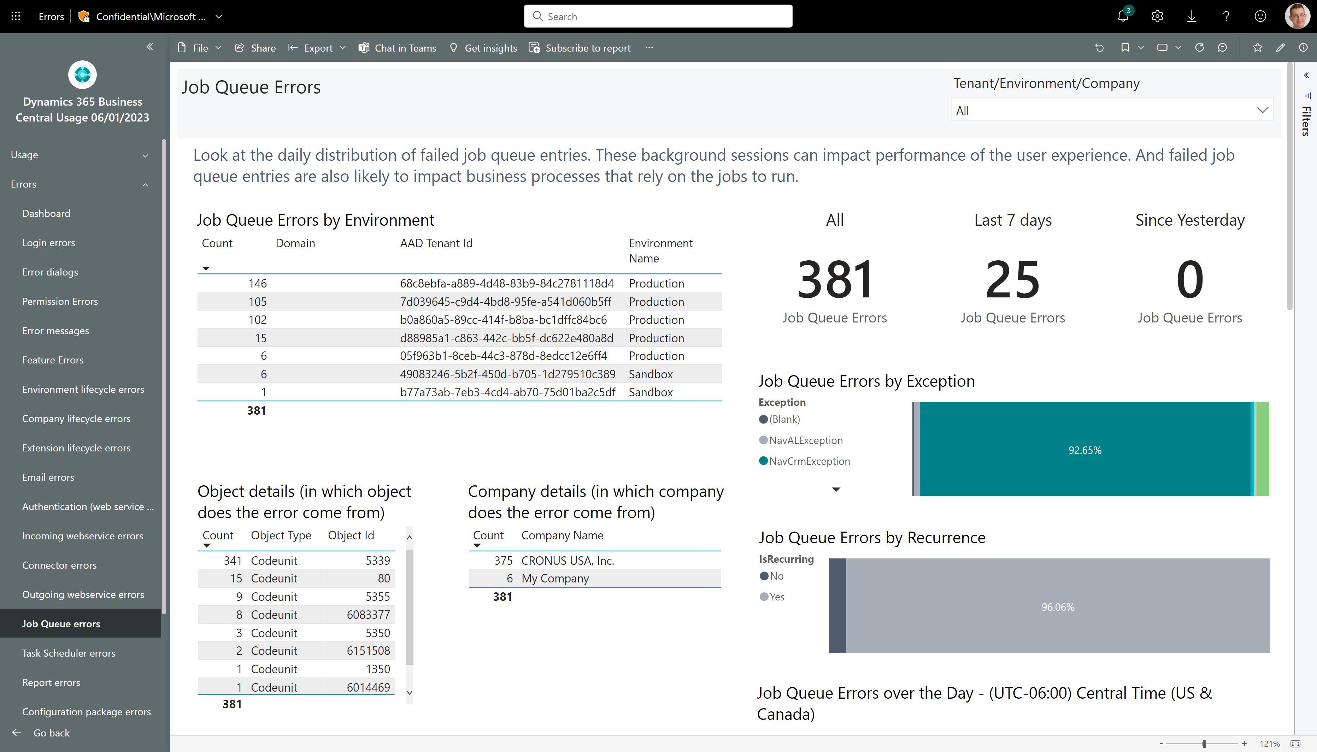
New in February 2023 release: All/Last 7 days/Since Yesterday measures on all error pages

Slide 32
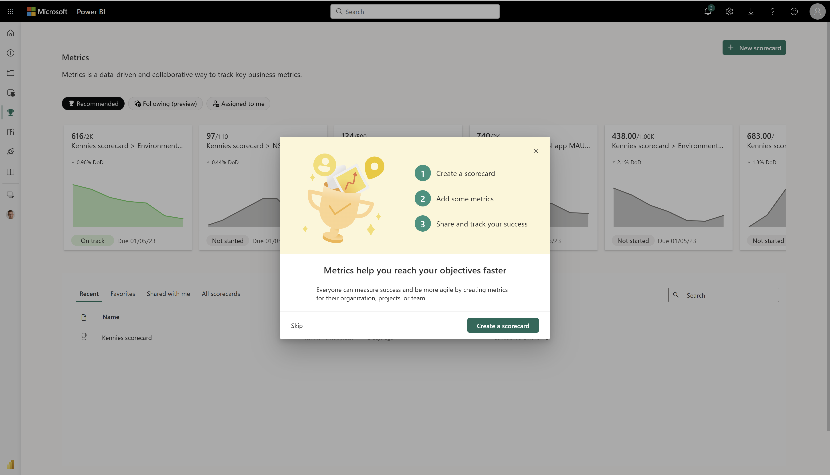
Add Power BI Metrics to the mix…

Slide 33
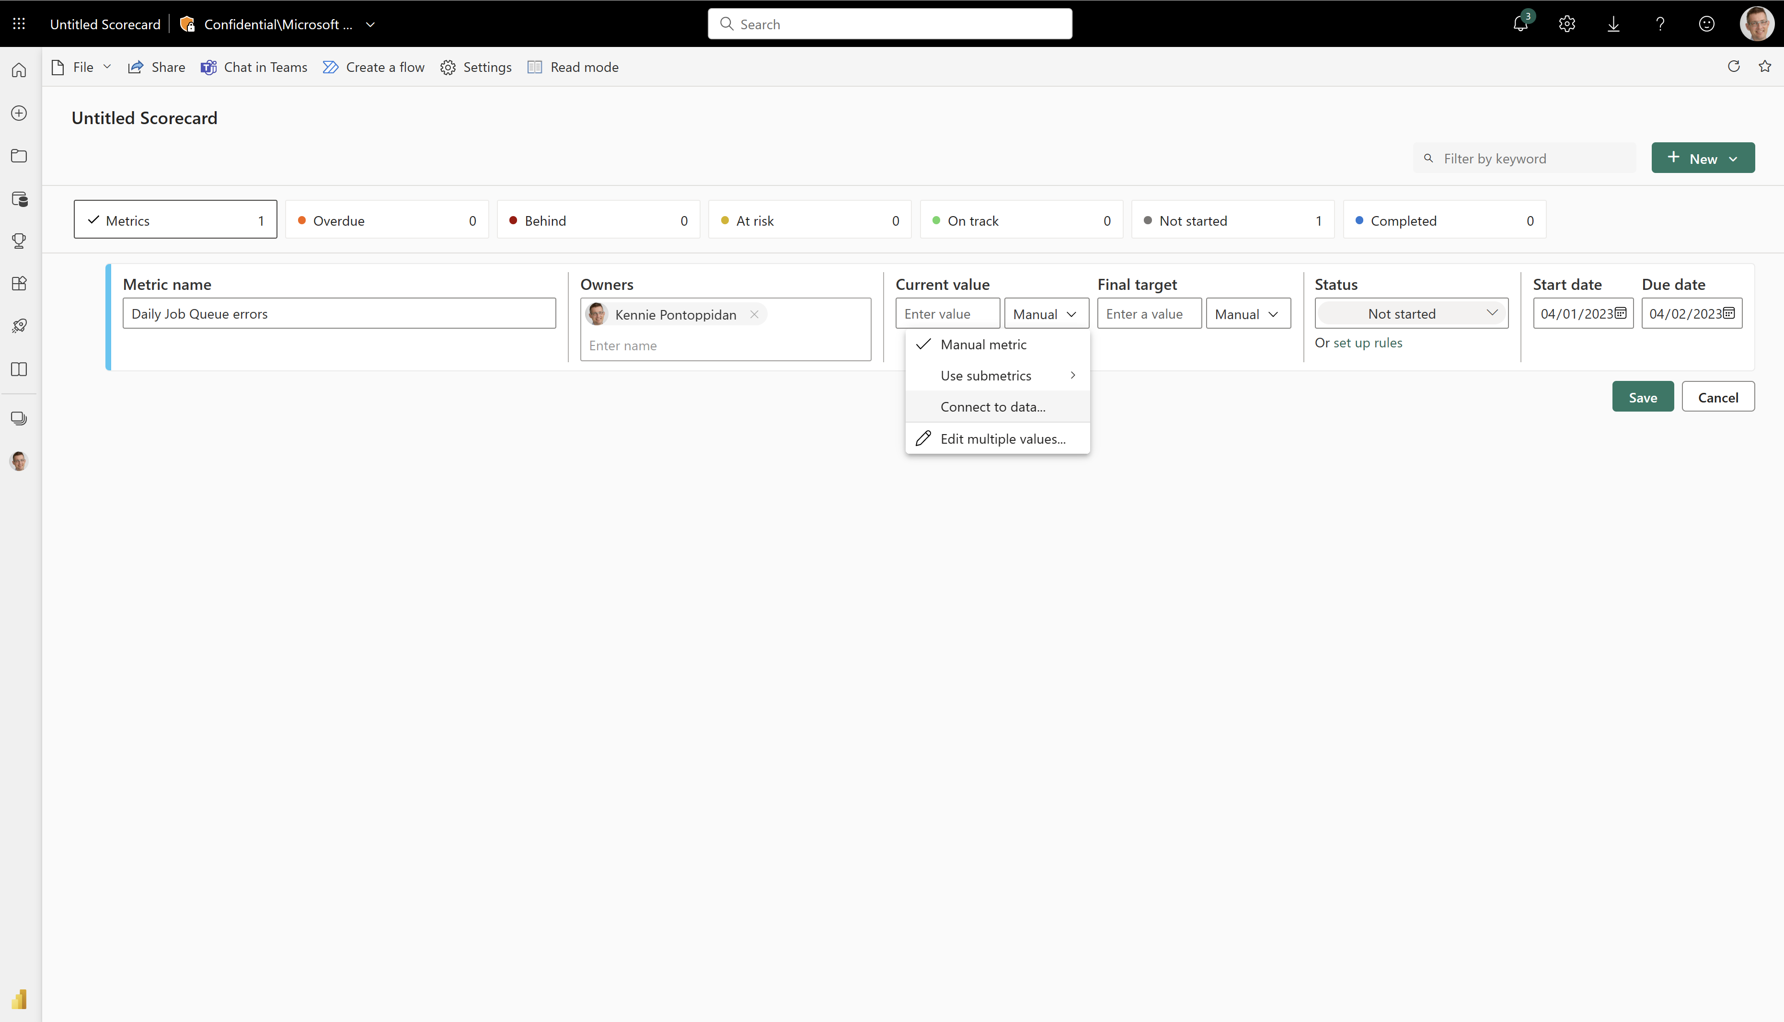

Slide 34
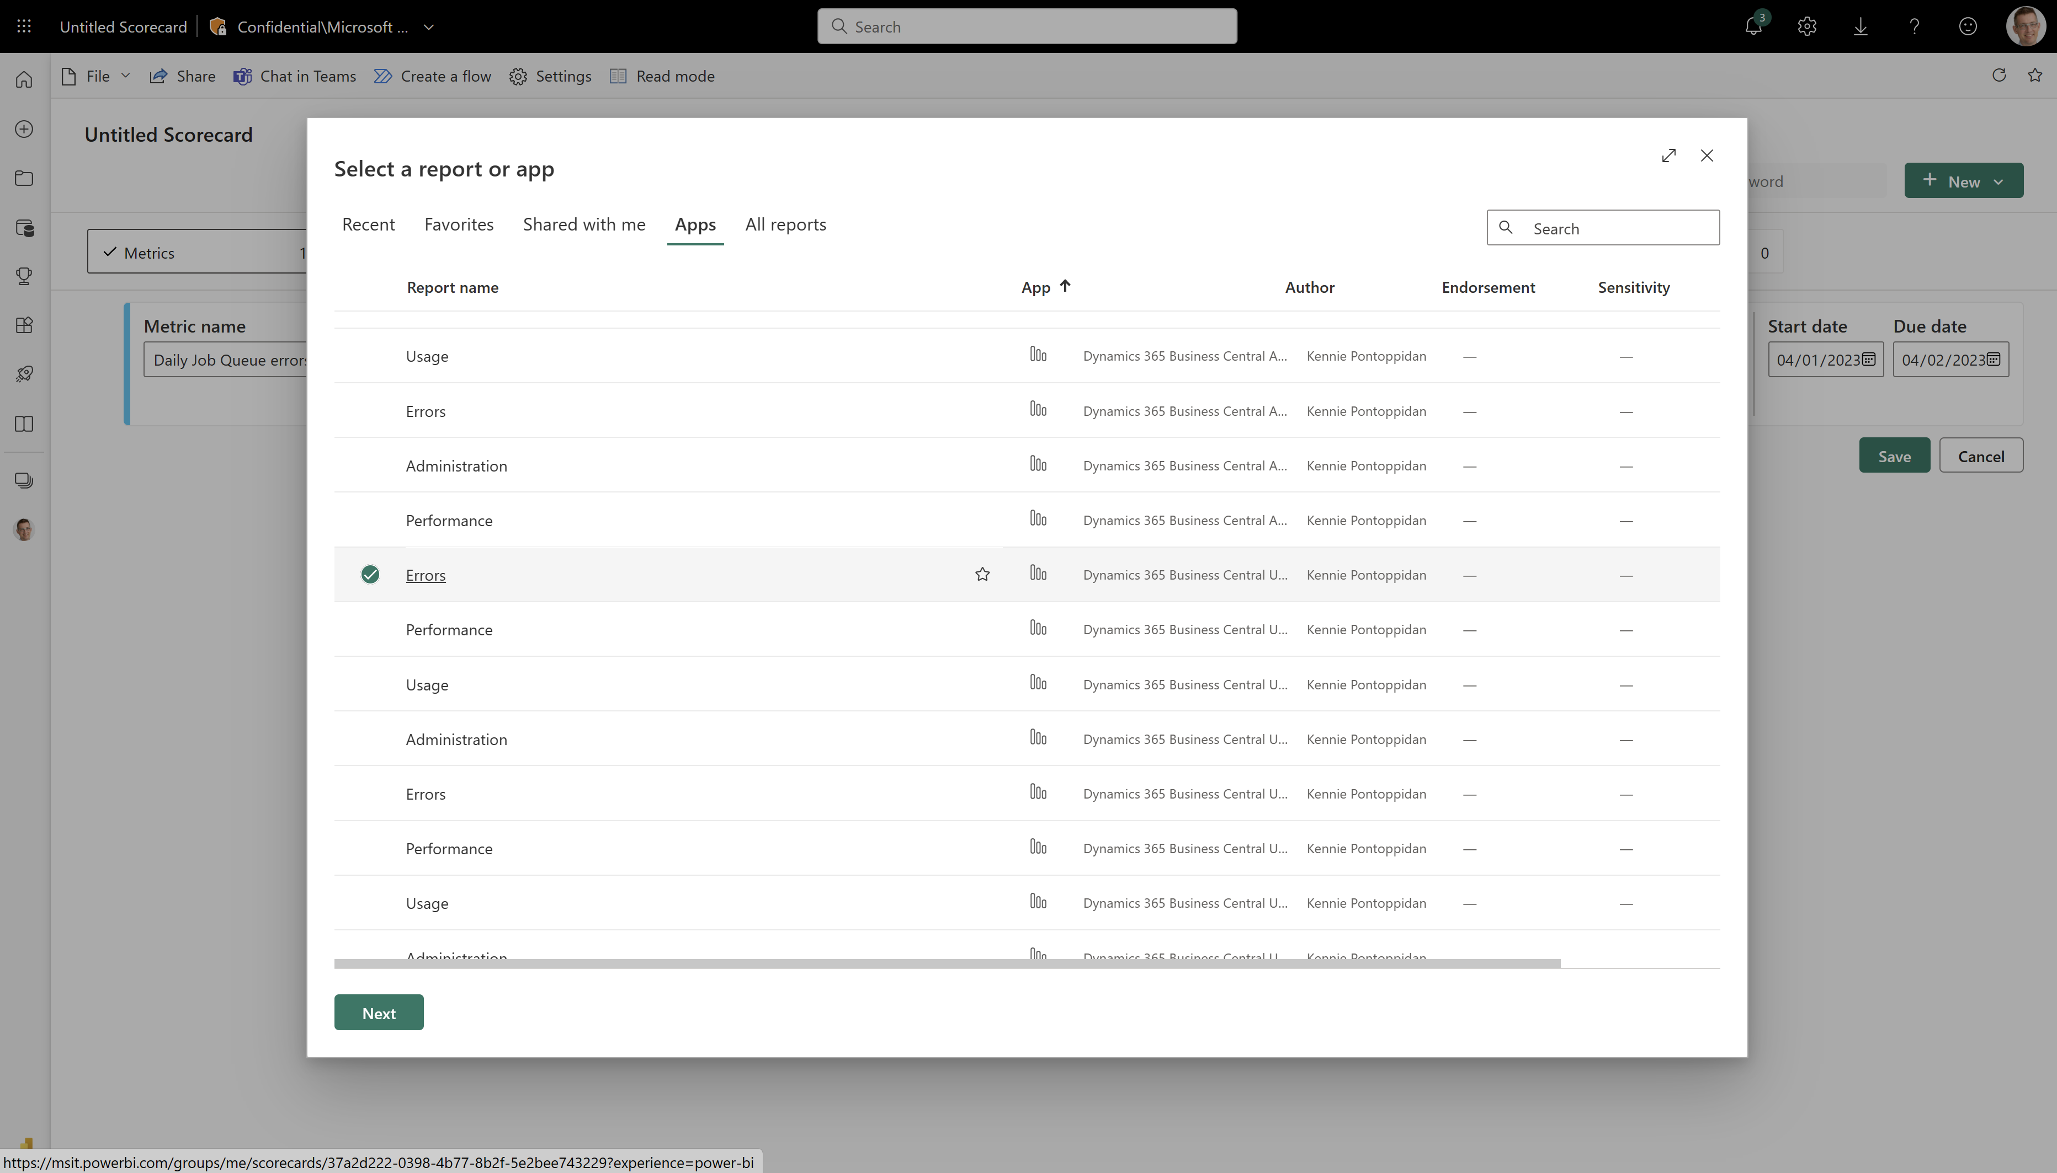

Slide 35
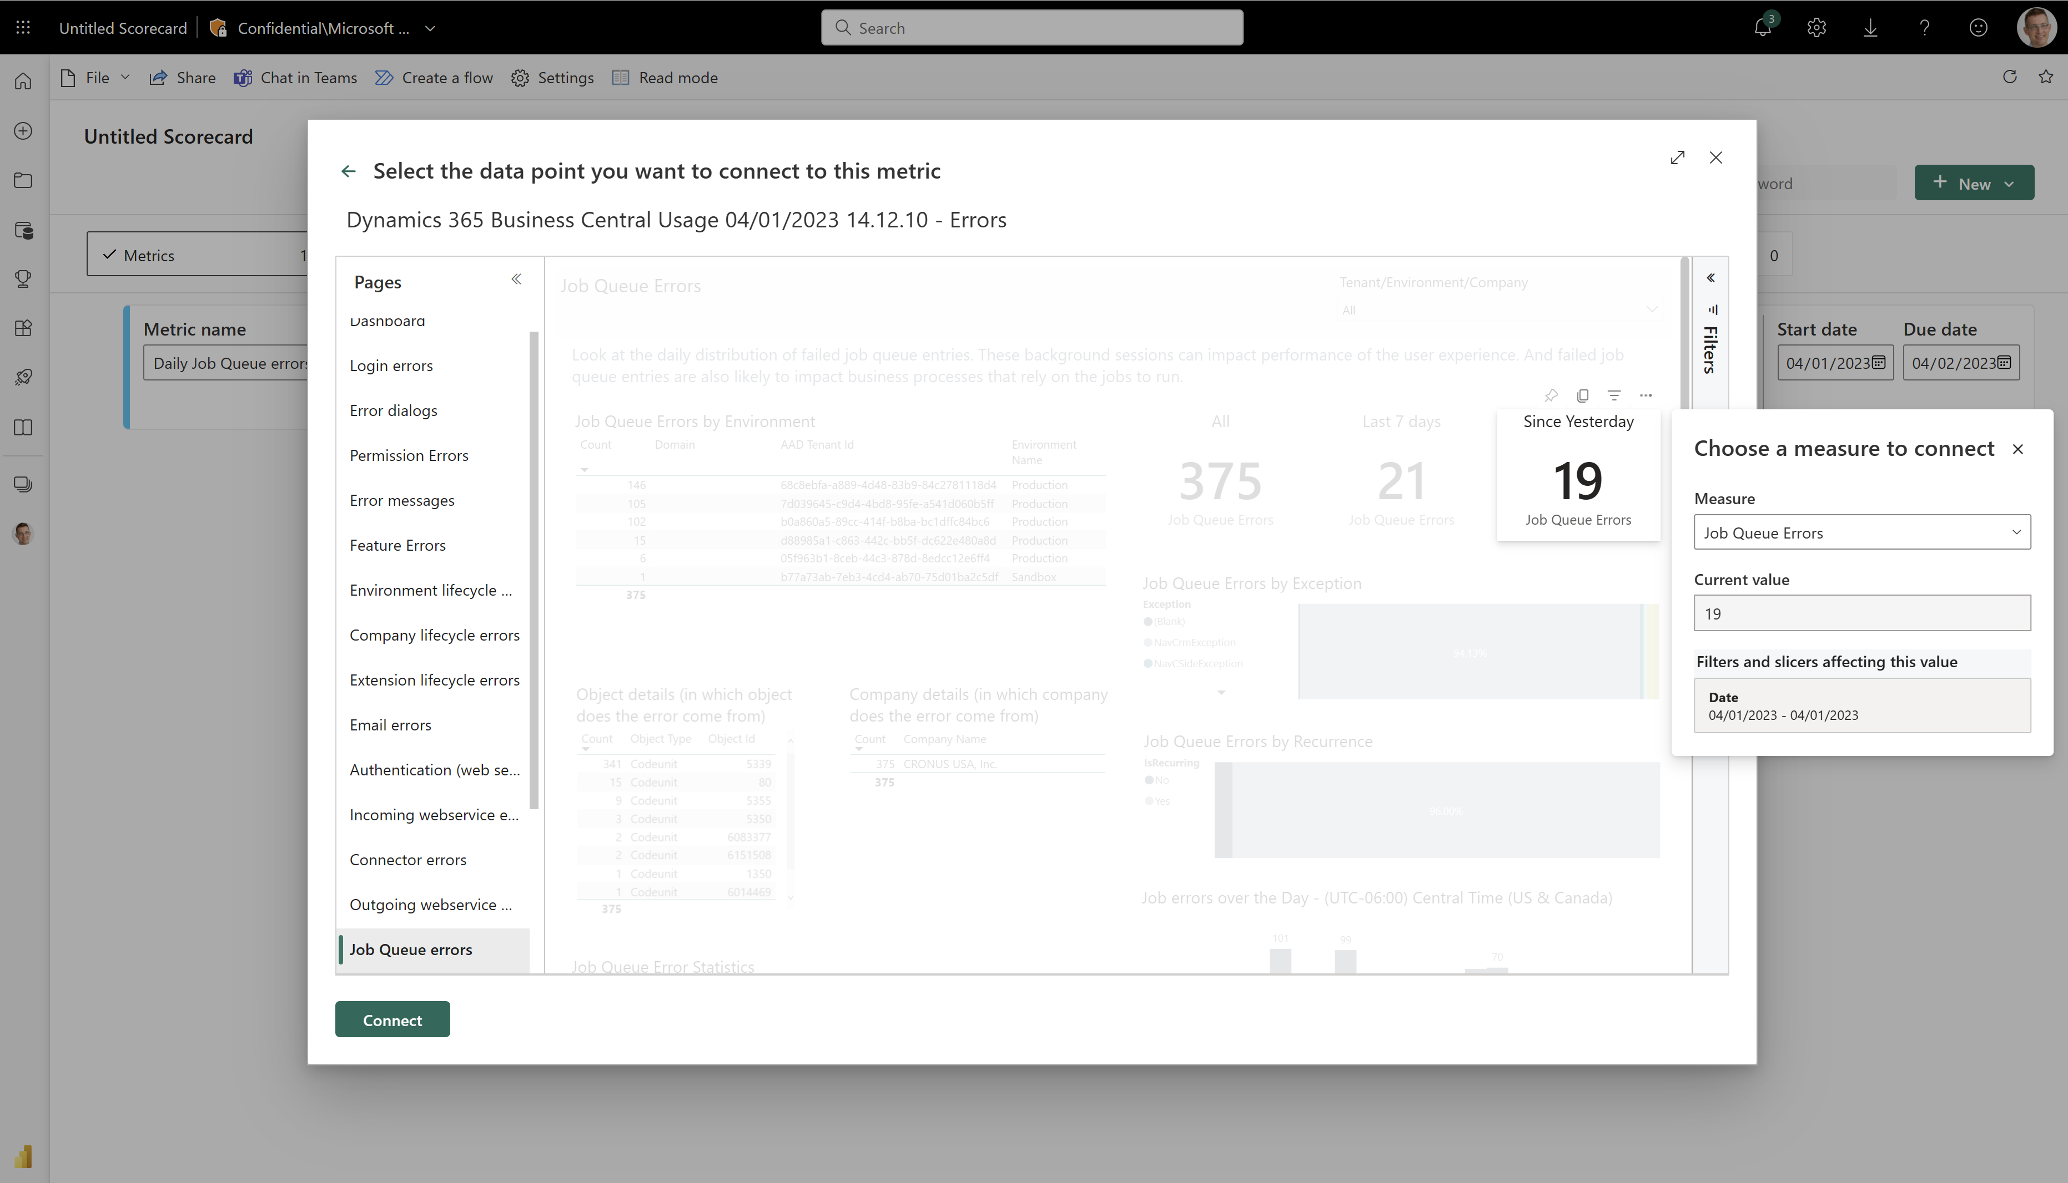

Slide 36
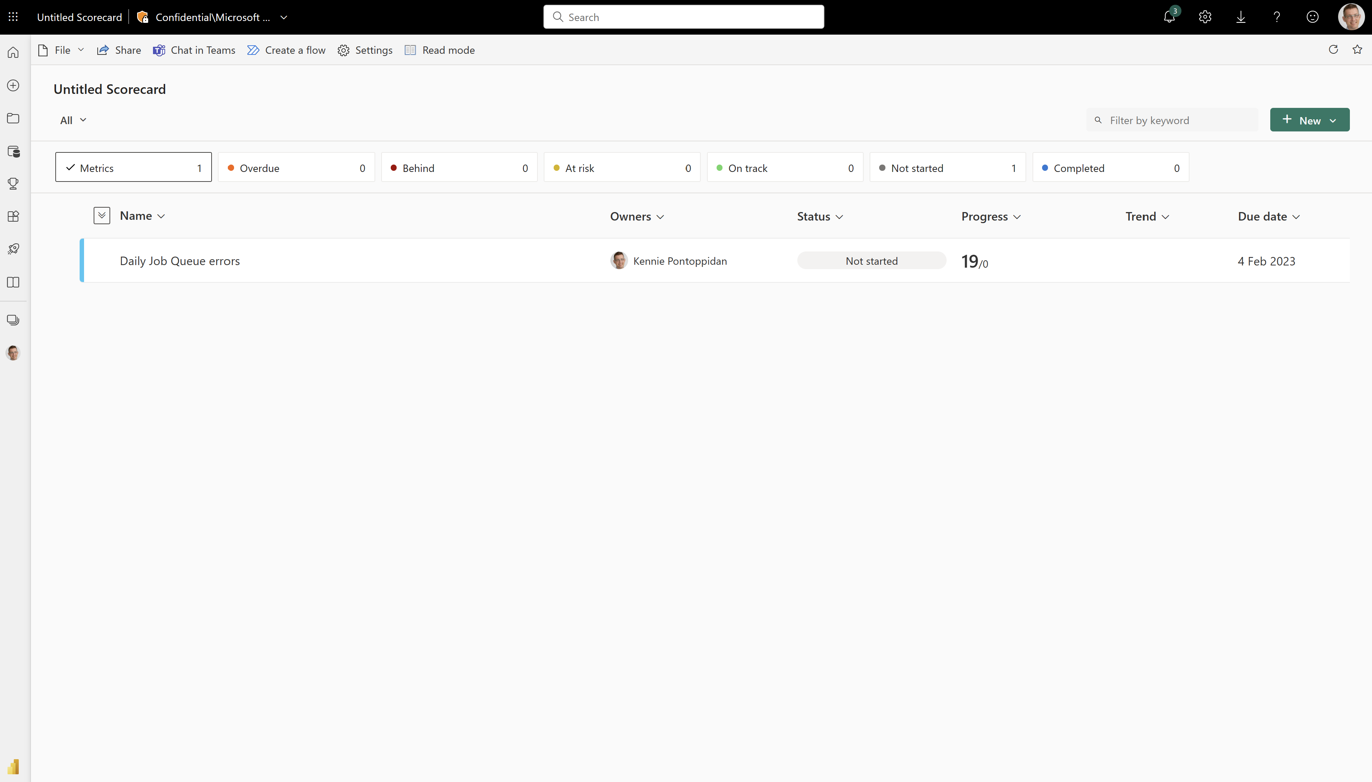

Slide 37
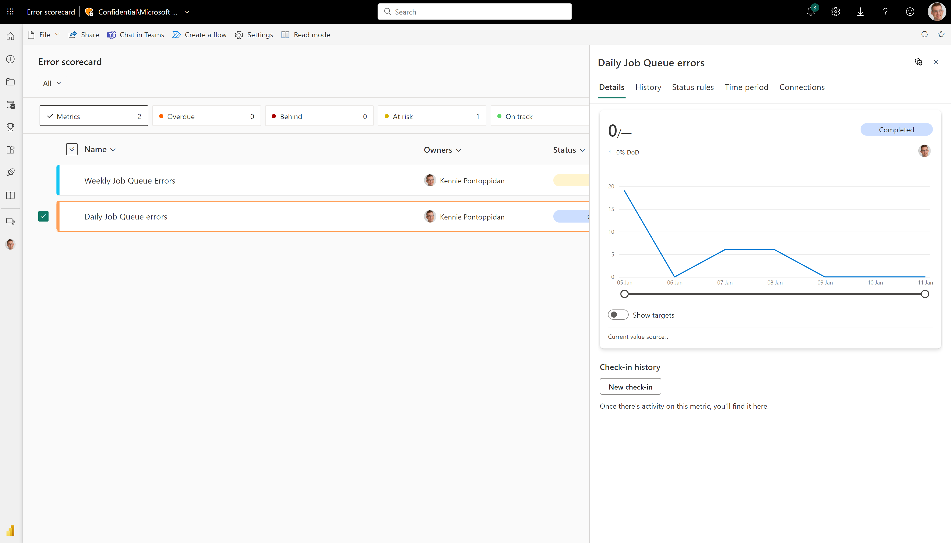
Let it simmer for a few days…

Slide 38
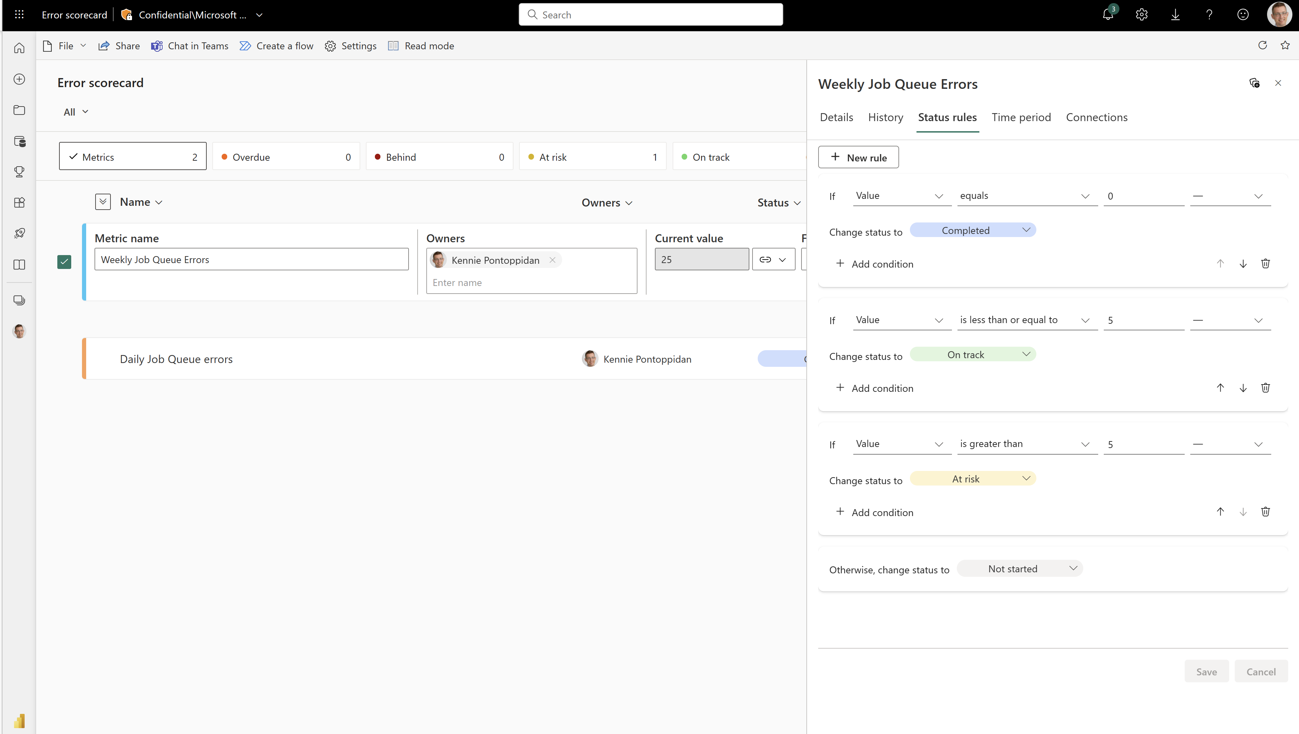
And setup state rules for status

Slide 39
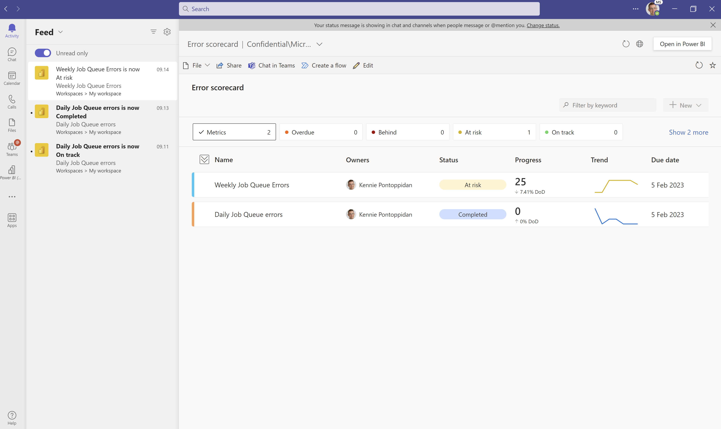
State changes goes automagically to Teams

Slide 40
Summary – data-driven go-lives
Set up telemetry
Provides data for everything
Install and configure the Power BI app
Gives visibility into usage, errors, and performance for the project team and the customer sponsor
Setup Power BI metrics on key error types
Helps track progress of errors before/during go-live
Setup Alerts on key error types
Helps track progress of errors after go-live

Slide 41
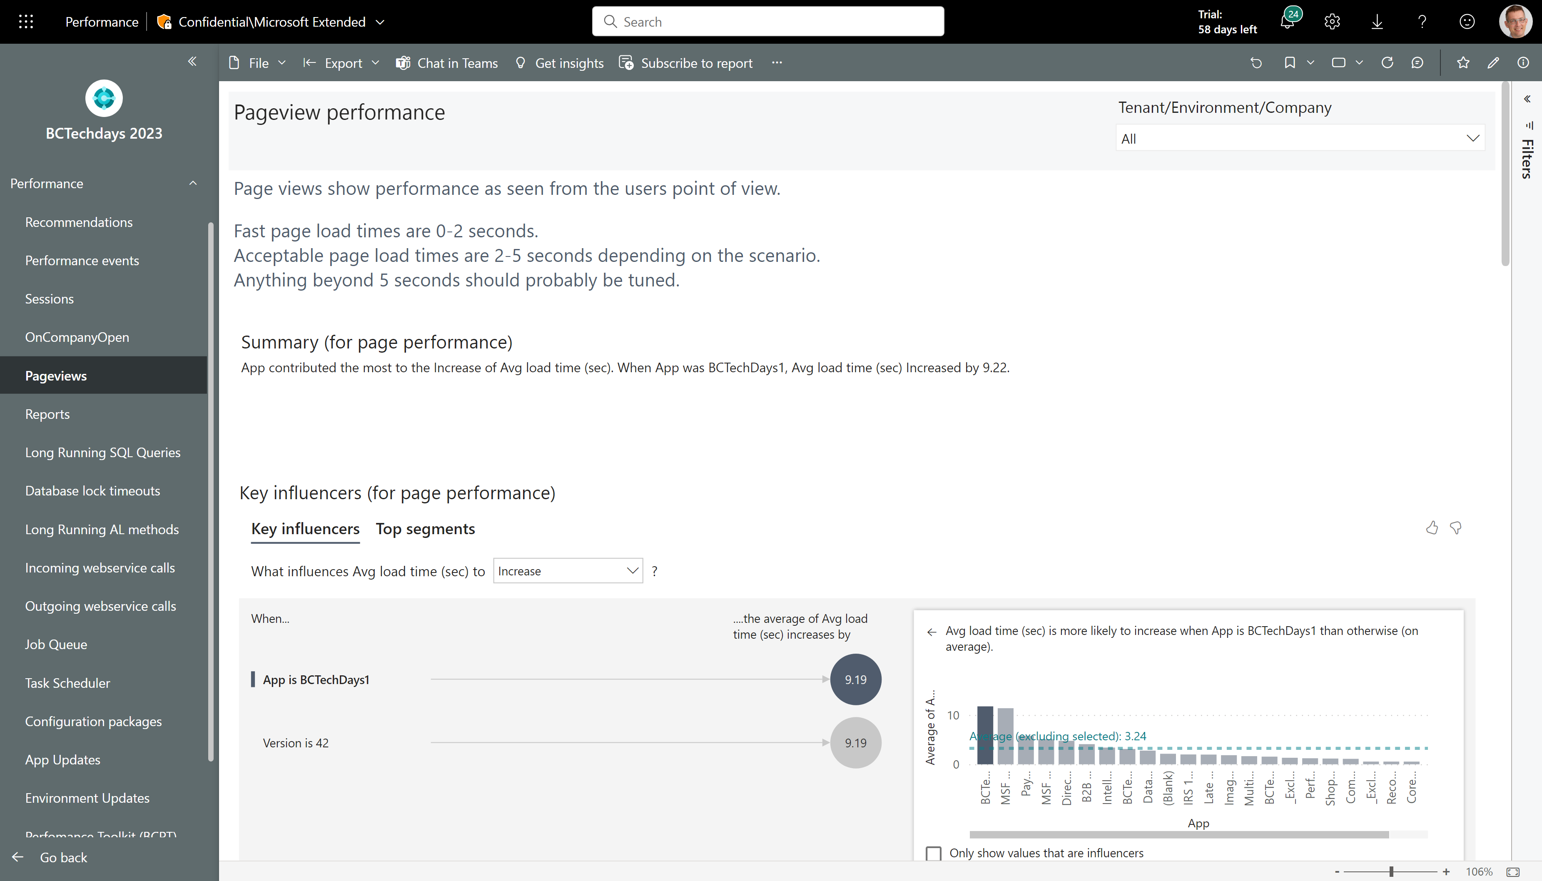
AI assisted performance analysis
Most pages in the performance report has these overview visuals:
An AI generated summary in English
AI generated key influencers to performance metrics
AI generated segmentation of the dataset for this page
An AI guided decomposition tree where you can analyze patterns
Top 10 slowest entities
Top 10 slowest entities over time

Slide 42
AI assisted performance analysis - summary
AI generated summary in English (might not show anything if there is not enough data for the AI to analyze.)

Slide 43
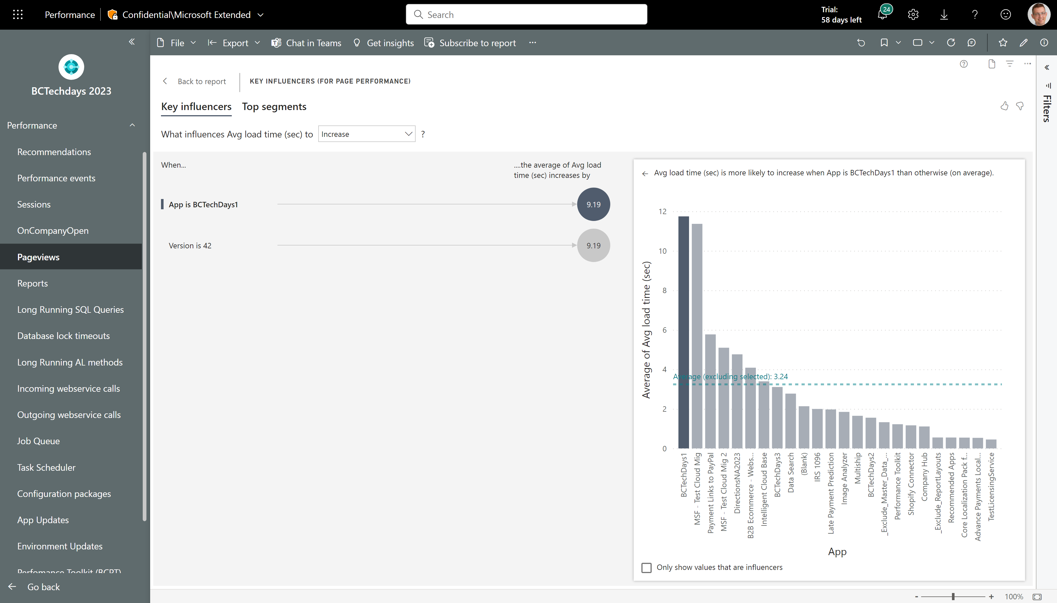
AI assisted performance analysis - key influencers
AI generated key influencers to performance metrics (might not show anything if there is not enough data for the AI to analyze.) Click on an insight to compare to the average of the full population.

Slide 44
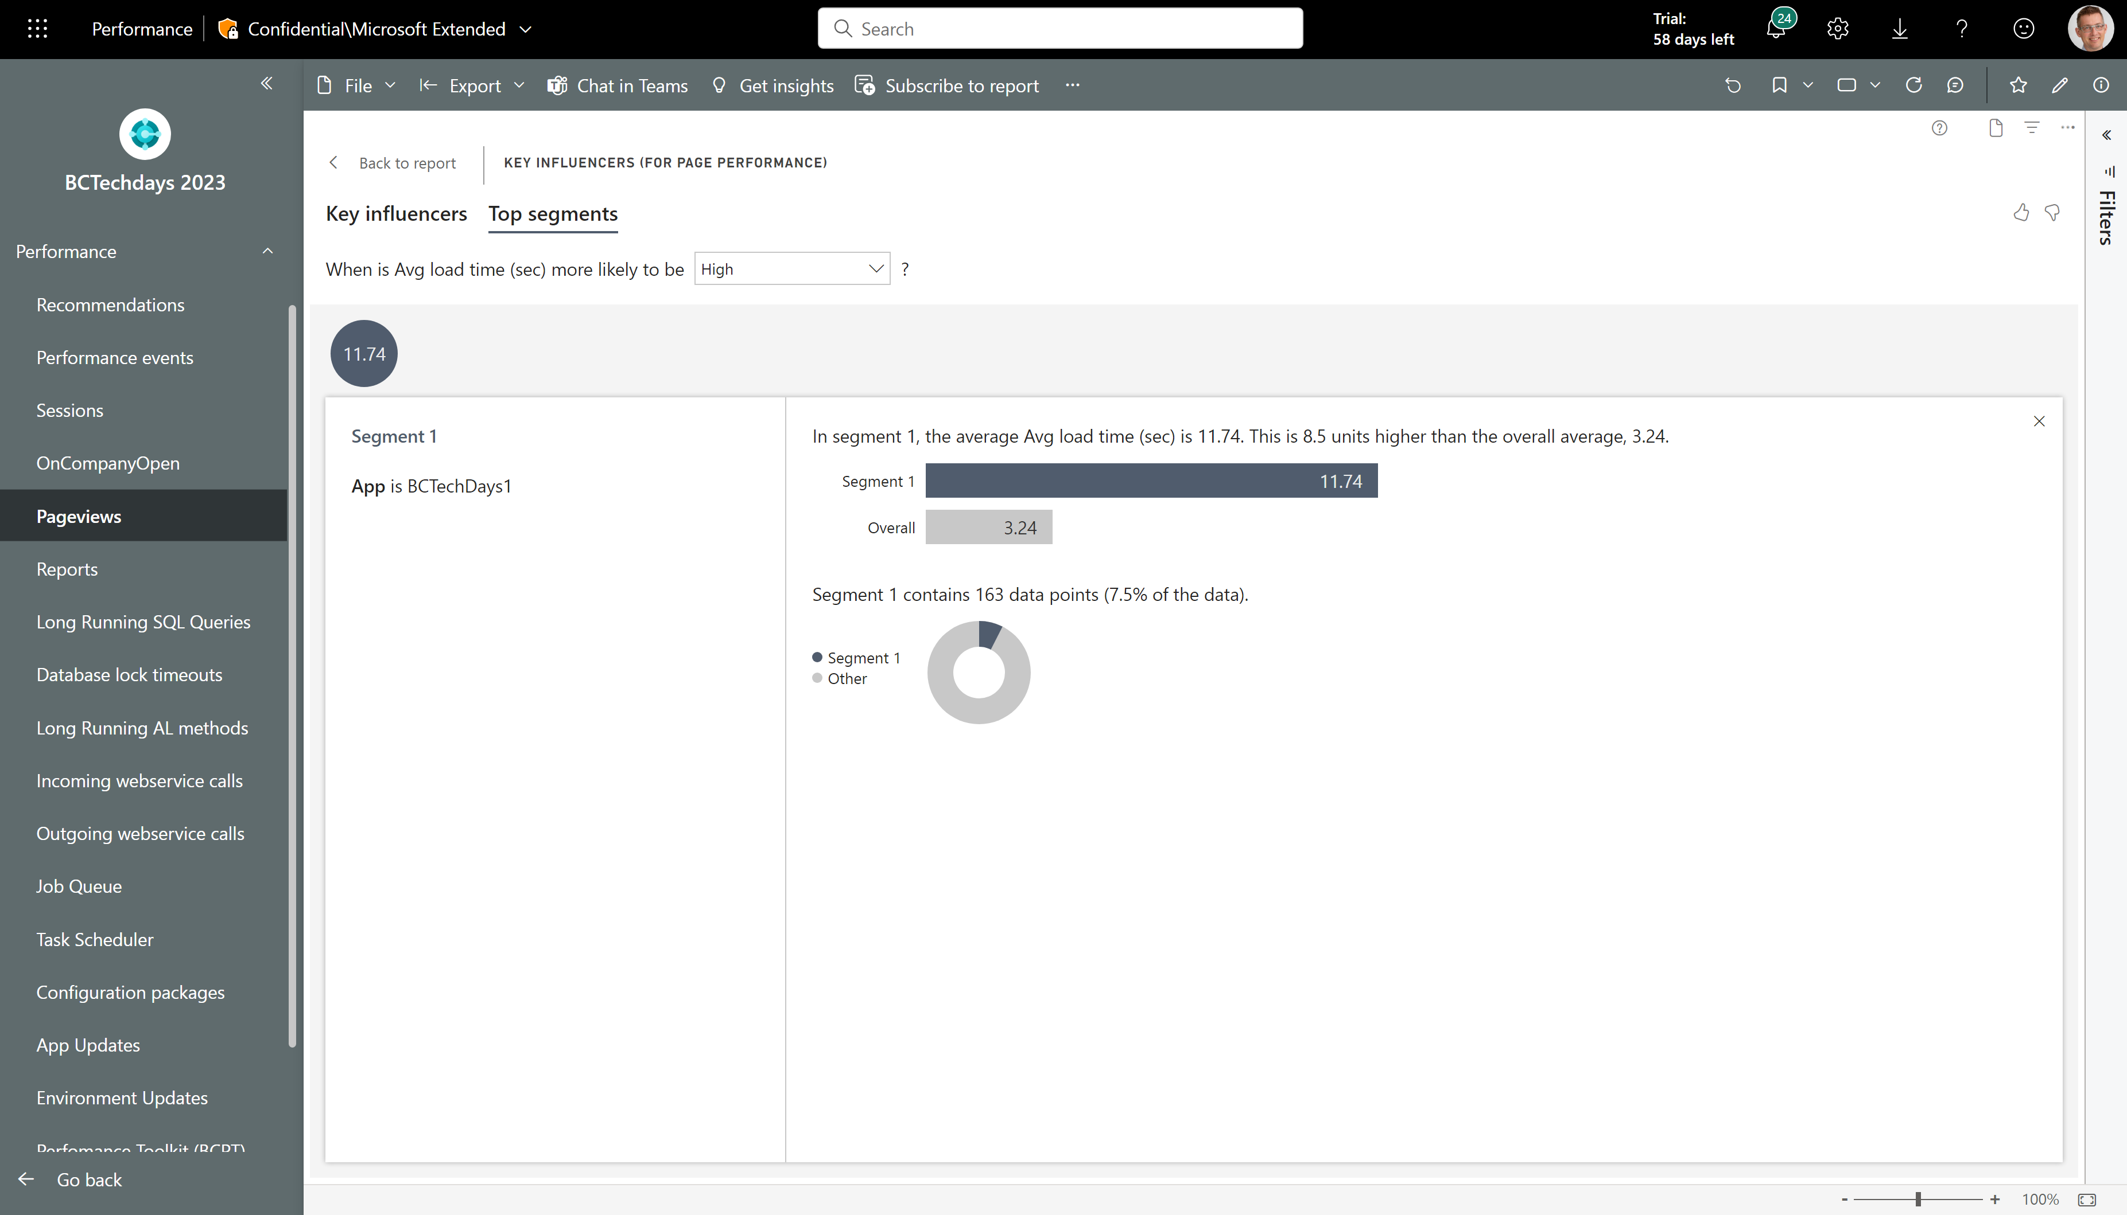
AI assisted performance analysis – Top segments
AI generated segmentation of the dataset for this page (might not show anything if there is not enough data for the AI to analyze.) Click on a segment to learn more

Slide 45
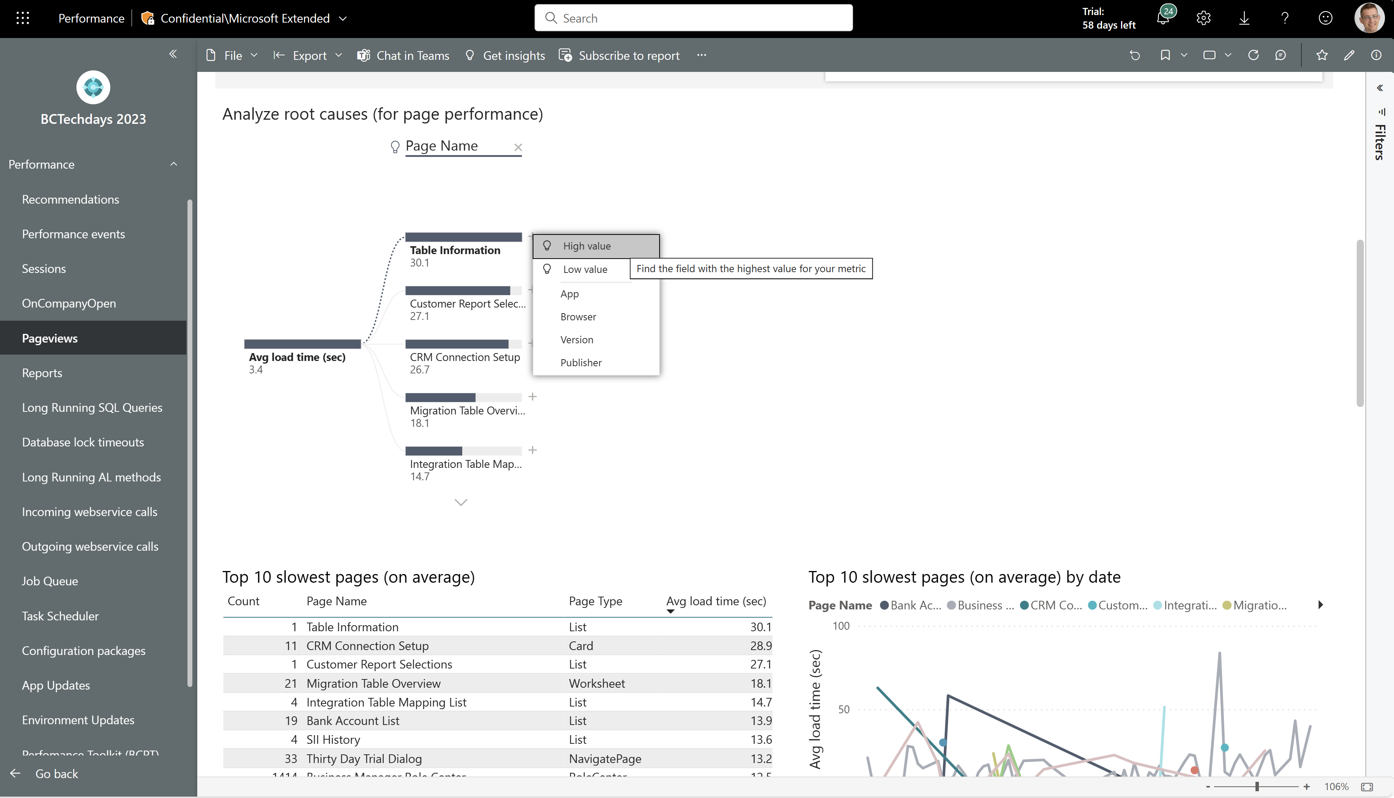
AI assisted performance analysis – Analyze root causes
An AI guided decomposition tree where you can analyze patterns.
Let AI pick the next step (see the light bulp icons) or pick the dimension you want to explore.

Slide 46
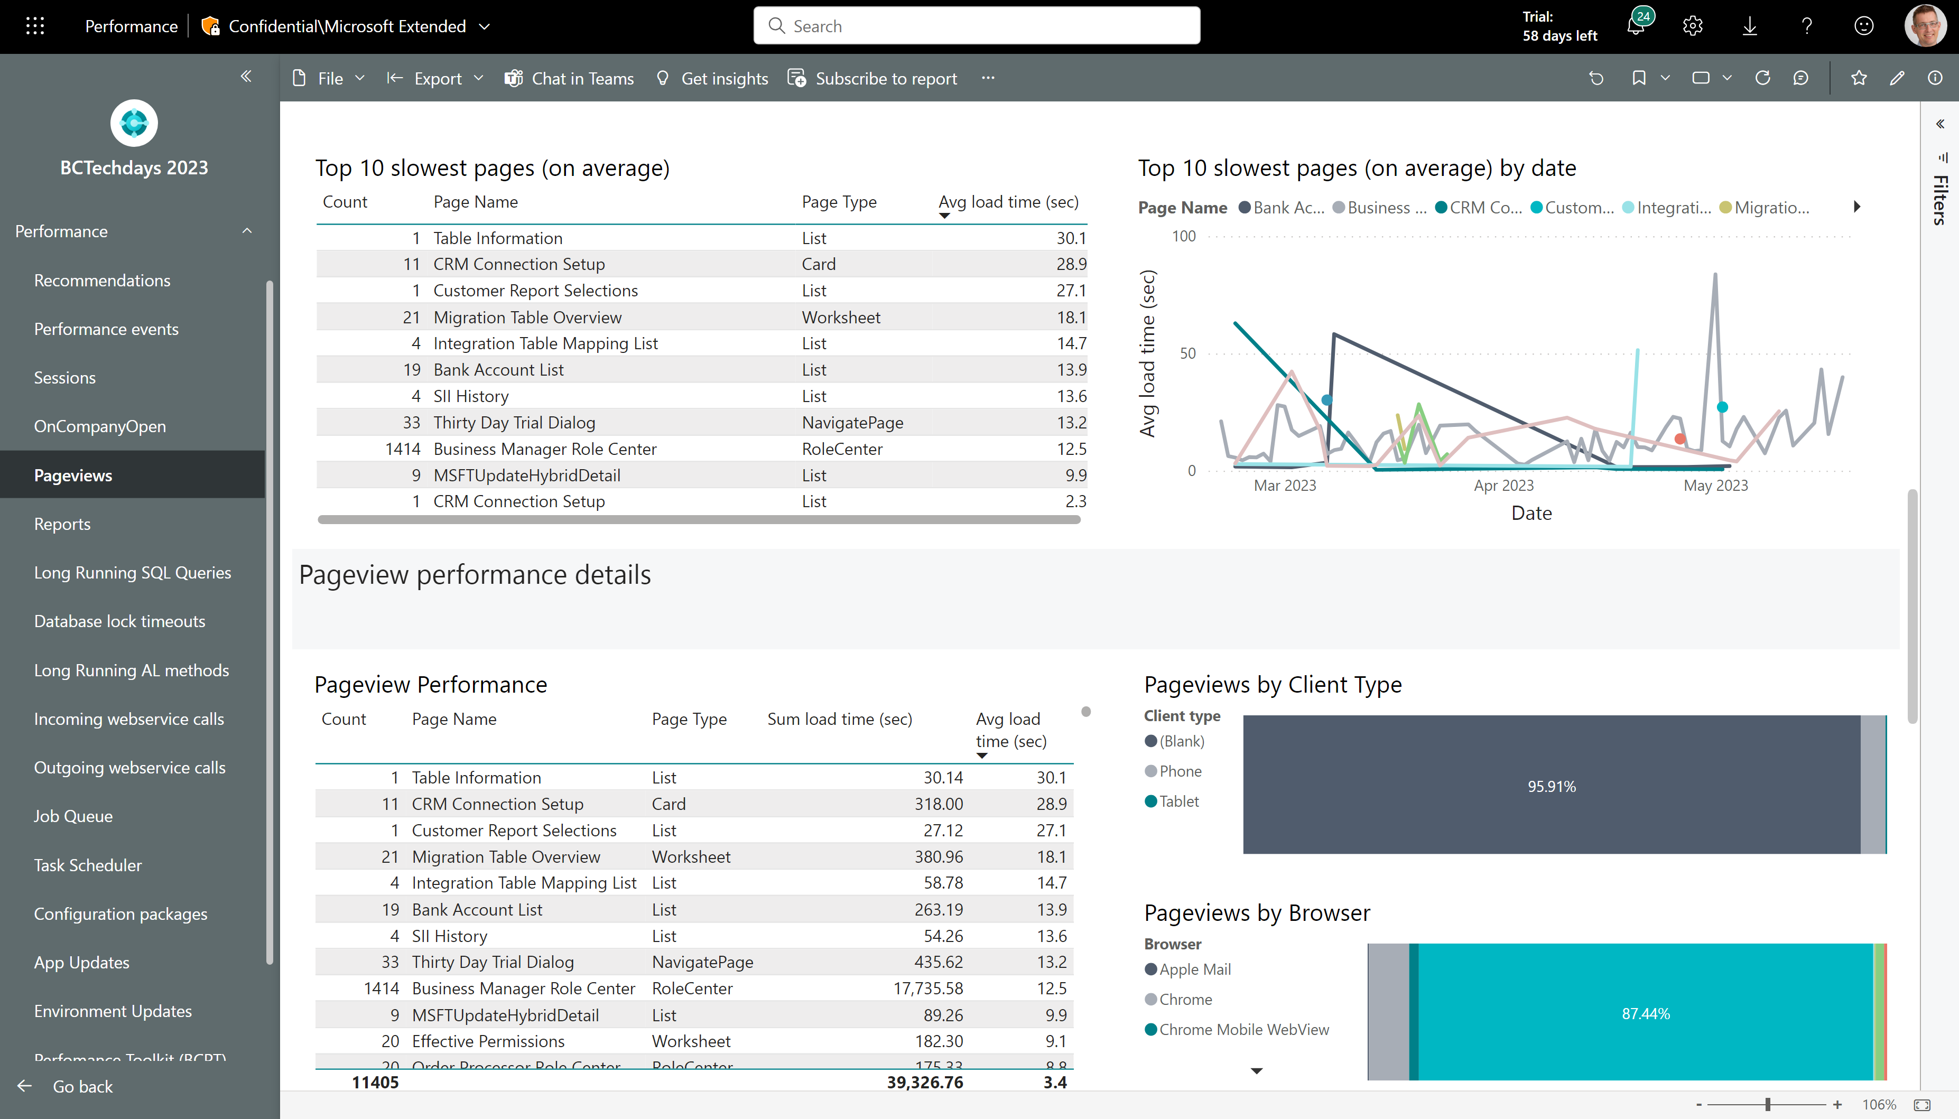
AI assisted performance analysis – Top 10 slowest
See top 10 slowest entities (on average) and top 10 slowest entities over time
Pick one row and then scroll down to the detail report (which is now filtered to your choice)

Slide 47
Maturity model

Slide 48
Maturity model*
Pervasive
Strategic
Focused
Tactical
Unaware
Have just enabled
telemetry
Select roles
use telemetry
Projects include
telemetry
Cross-customer (or cross-app) use
Pervasive
Telemetry enables
proactiveness
*inspired by the Gartner BI maturity model

Slide 49
Resources

Slide 50
aka.ms/bctelemetry

Slide 51
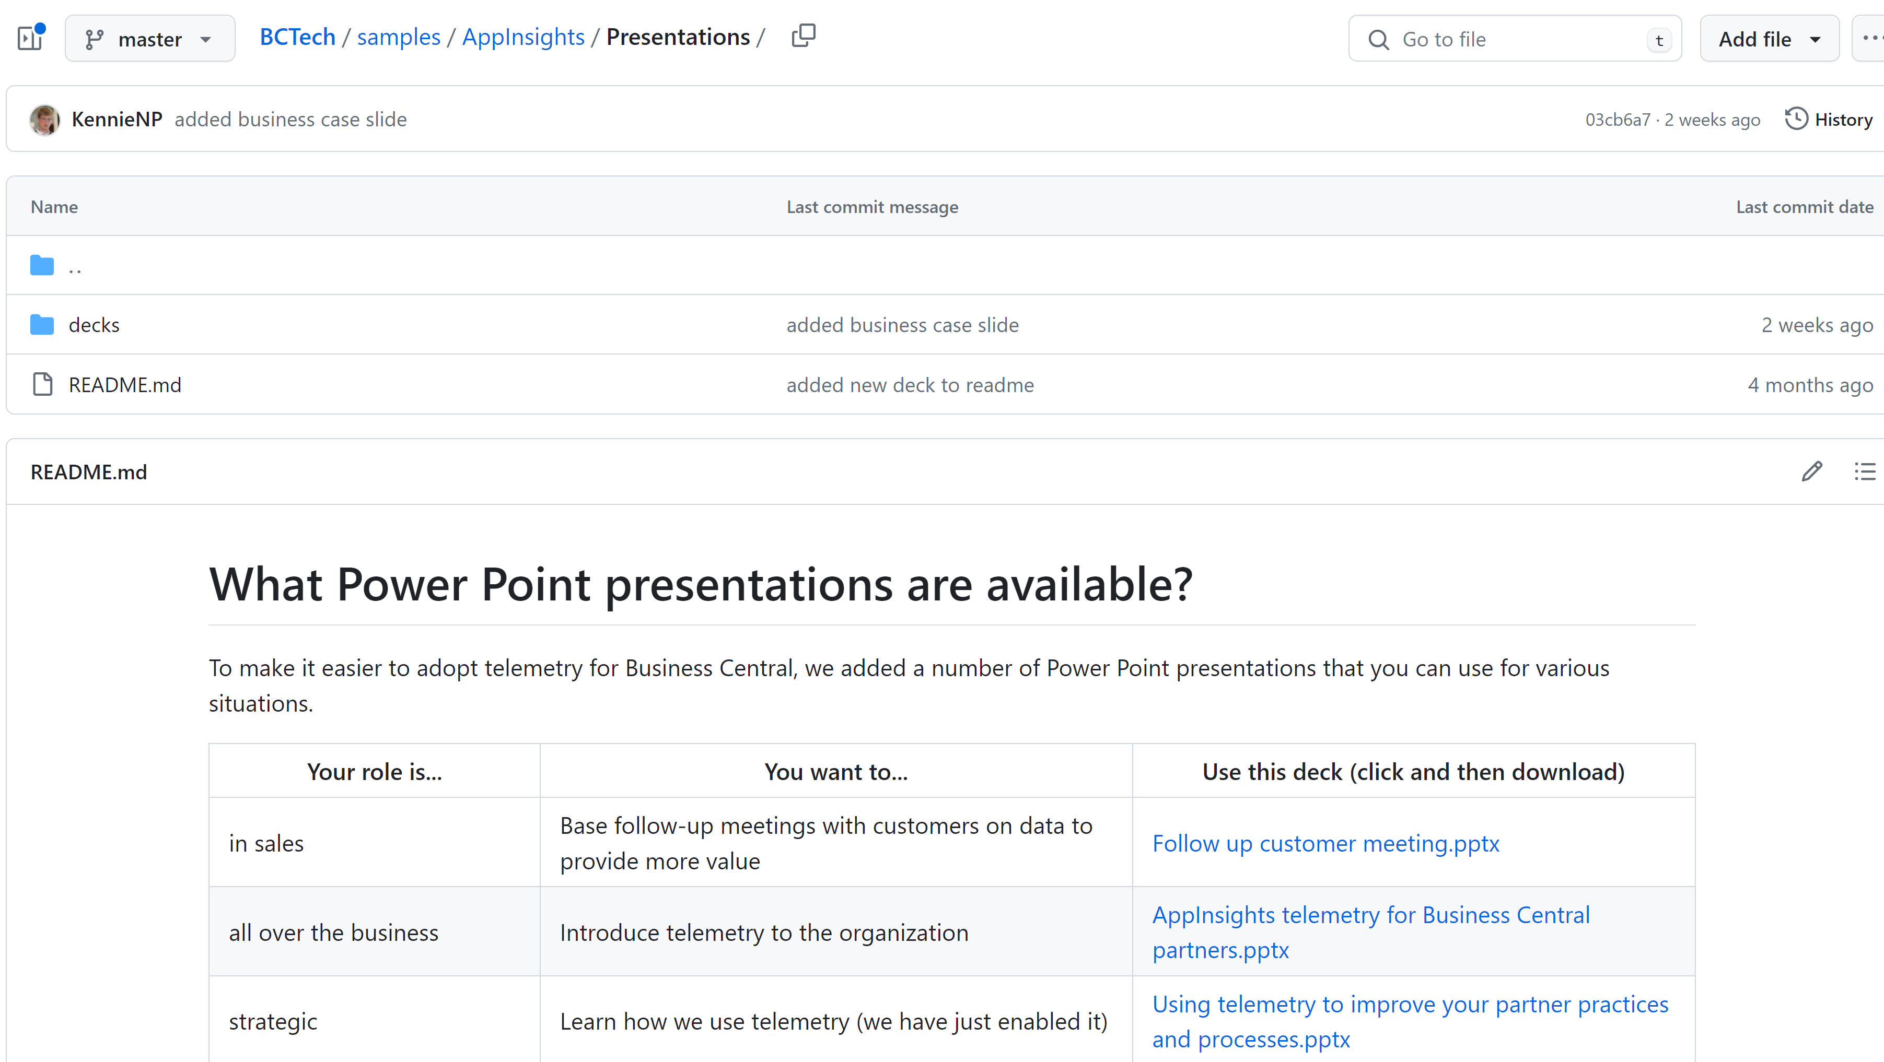
aka.ms/bctelemetrysamples

Slide 52
Get the apps from Appsource
For environment telemetry https://aka.ms/bctelemetryreport
For app telemetry https://aka.ms/bctelemetry-isv-app

